Slide 1
Presentation on:-
Software Development Life Cycle
Presented By:-
Varsha Harke

Slide 2
CONTENTS
Introduction
Requirements
Analysis and Design
Implementation
Testing
Deployment
Maintenance

Slide 3
INTRODUCTION
SDLC is a process which includes various phases that are followed to develop the software application
It includes following phases:
1. Requirements
2. Analysis and Design
3. Implementation
4. Testing
5. Deployment
6. Maintenance

Slide 4
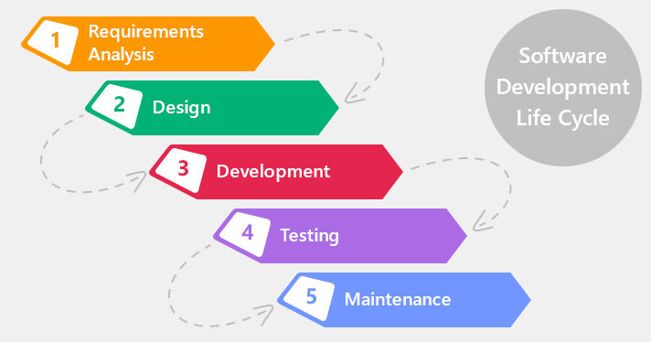

Slide 5
Requirement
Business requirement are gathered in this phase
Requirement elicitation analysis is a process of collection the requirements of a system from customer
Output:- SRS

Slide 6
Analysis and Design
High level design:- Overall design of system
Low level design:-Detailed design of system
Output:- Architectural plan, Database design, Module design, Screen design

Slide 7
Testing
It includes detection of defects in the software
Checking implemented functionality with respect to requirements
Output:- Test scenarios, Test cases, Test scripts and Defect report

Slide 8
Deployment
Deploy software
Creation of user manual
Output:- User manual, Release notes

Slide 9
Maintenance
Preventive
Corrective
Perfective and Adaptive
Output:- code change, change request

Slide 10
THANK YOU

