Slide 1
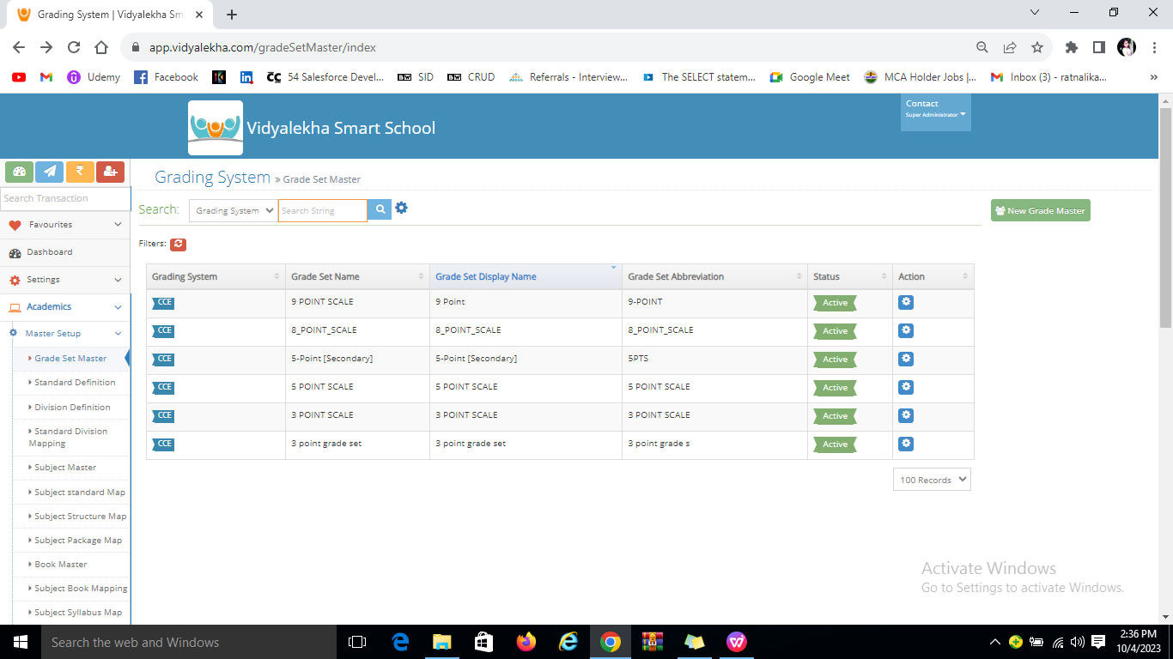
Academics
Master setup-Grade set Master
To create new grade you have to click on New Grade Master

Slide 2
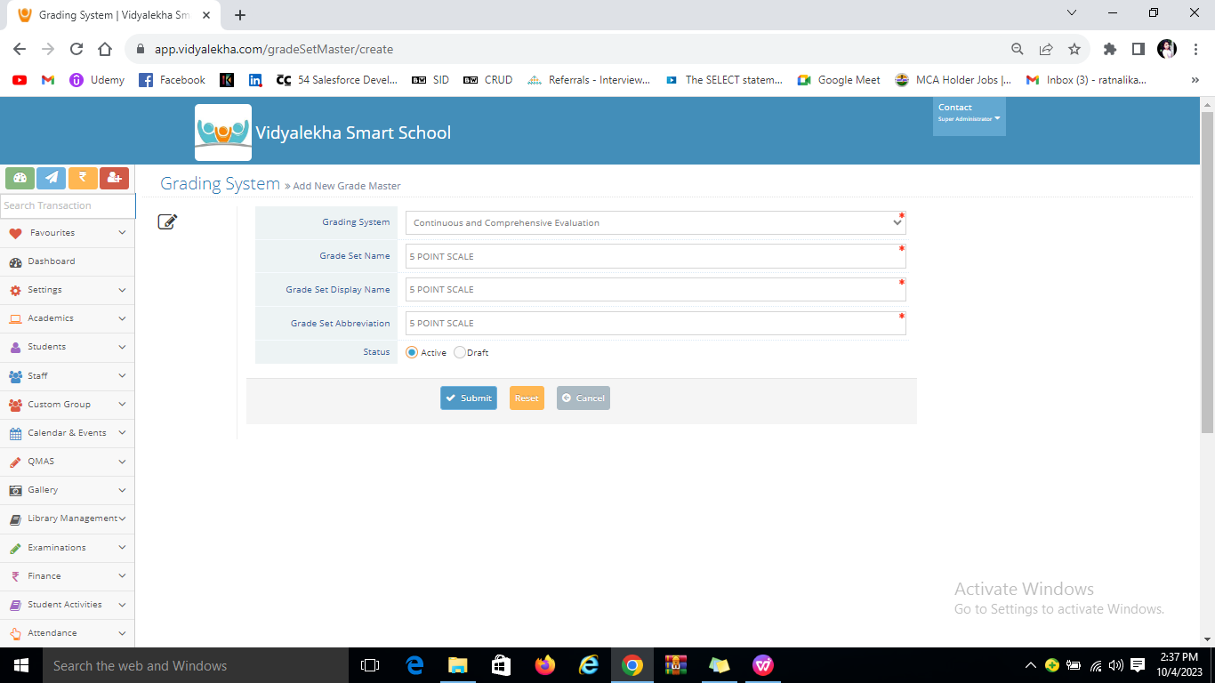
Fill the data and click on Submit button.

Slide 3
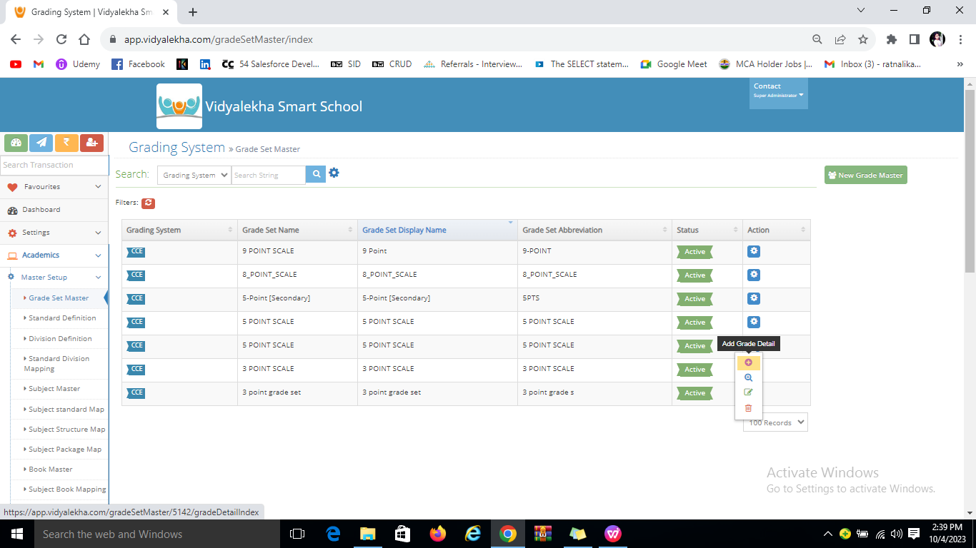
You can add grade details by clicking on action button.

Slide 4
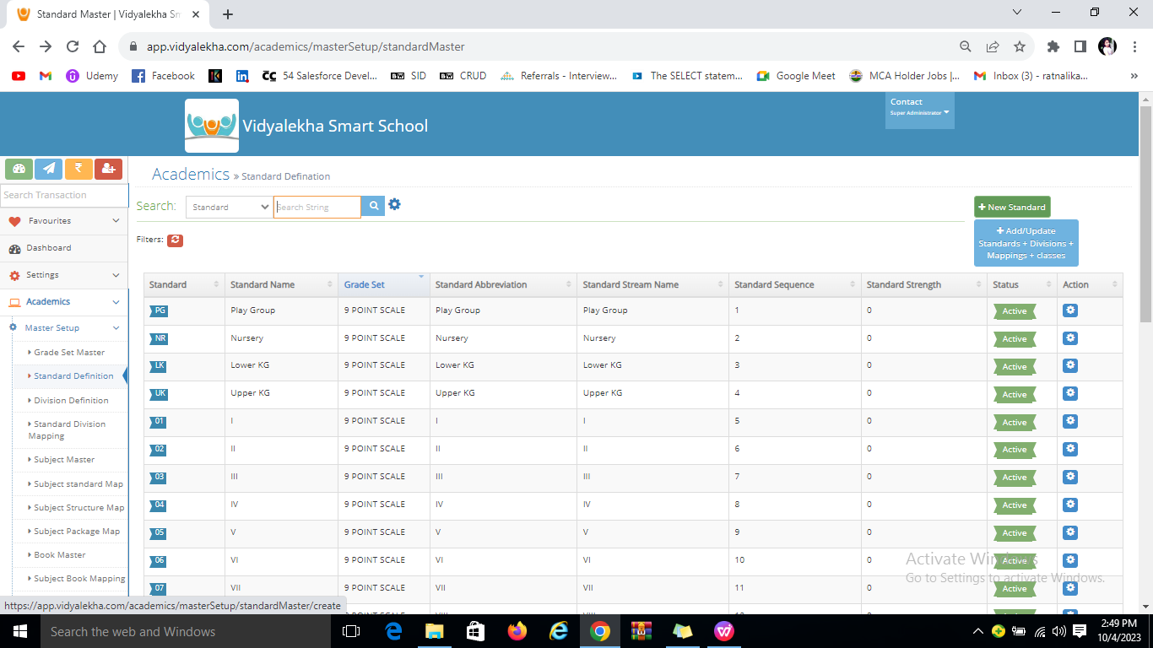
Standard Defination
To create Standard-you have click on New standard.
Fill the details and submit.

Slide 5
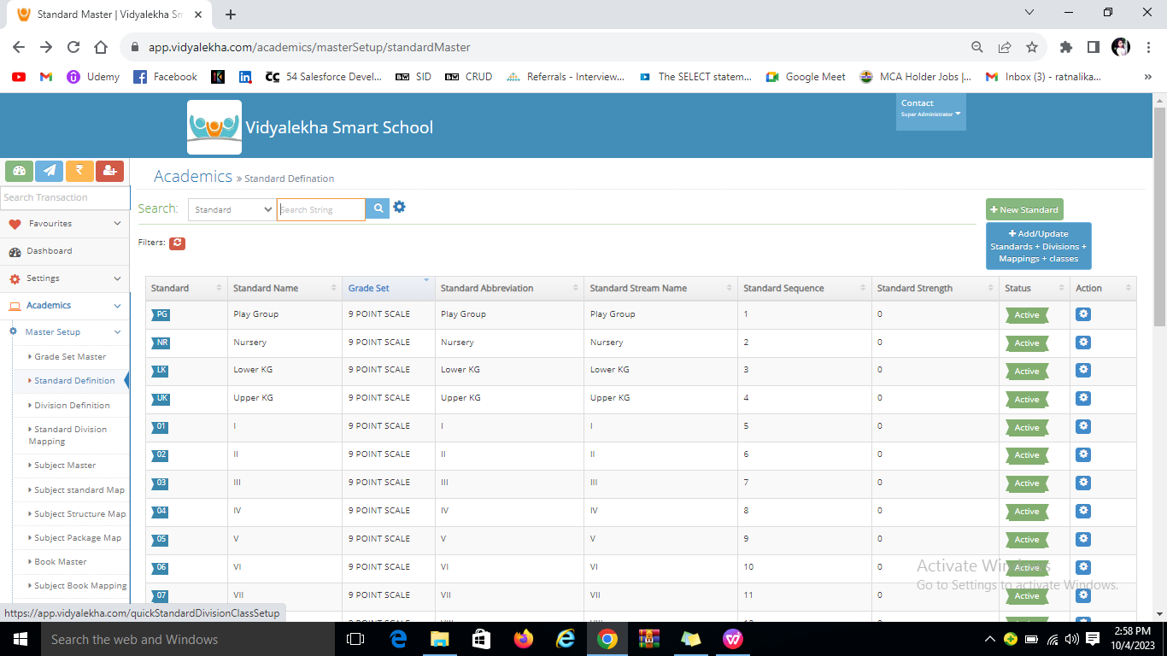
You can add,update standard,Divisions,classes and Mapping of standard class teachers,subject. by clicking on that pericular button.

Slide 6
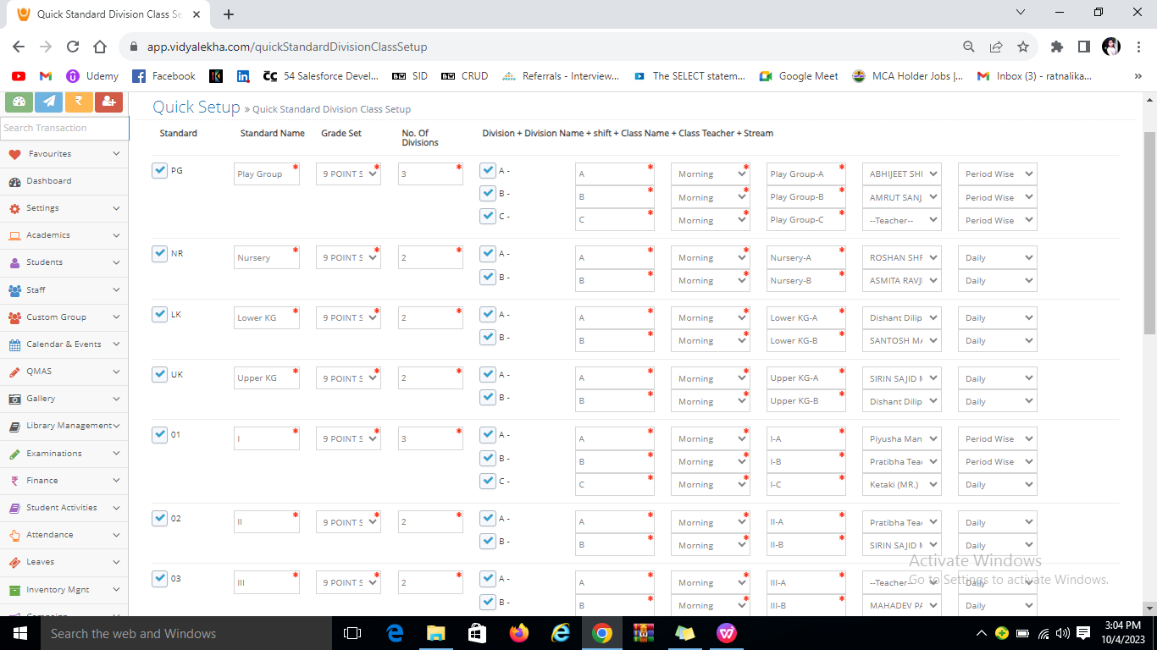
You can update data by clicking on perticular standard checkbox. create divisions,give names to the divisions,specify the grade set,create shift,specify class teacher name,Attendance type etc. and click on submit.

