Slide 1
Our school
Sufiyaan lm 10

Slide 2
Our school
  Our school is very best
Our school as many branches
Our school is very big
Our school garden is very big

Slide 3
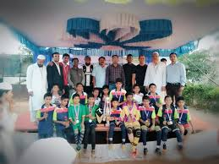

Slide 4
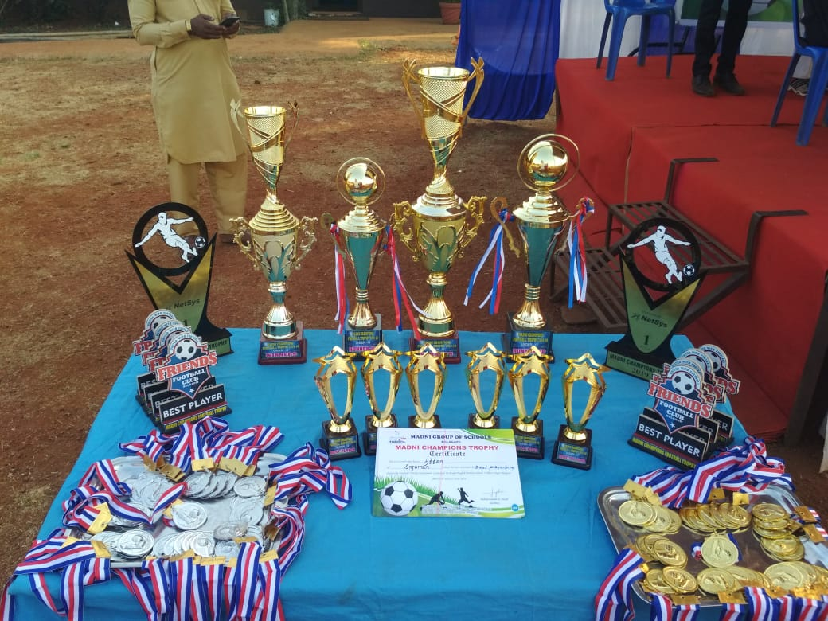

Slide 5
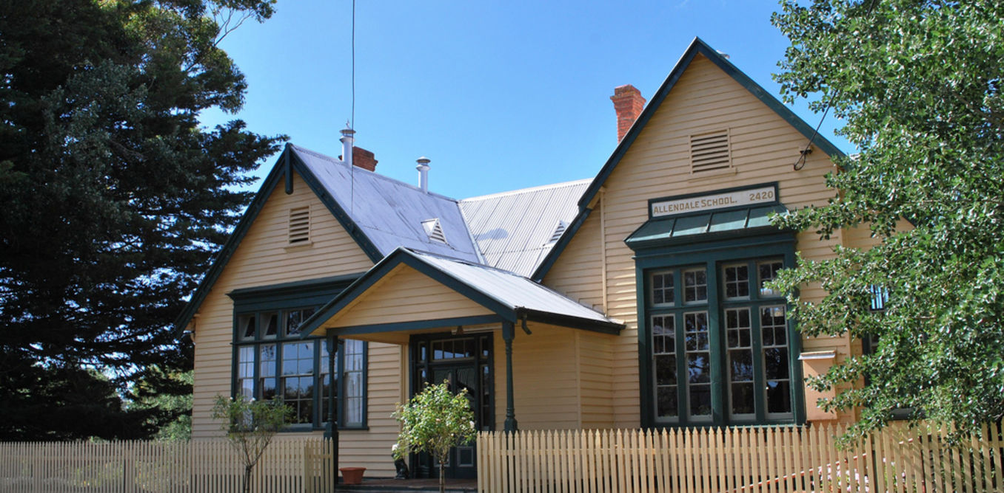


Slide 6
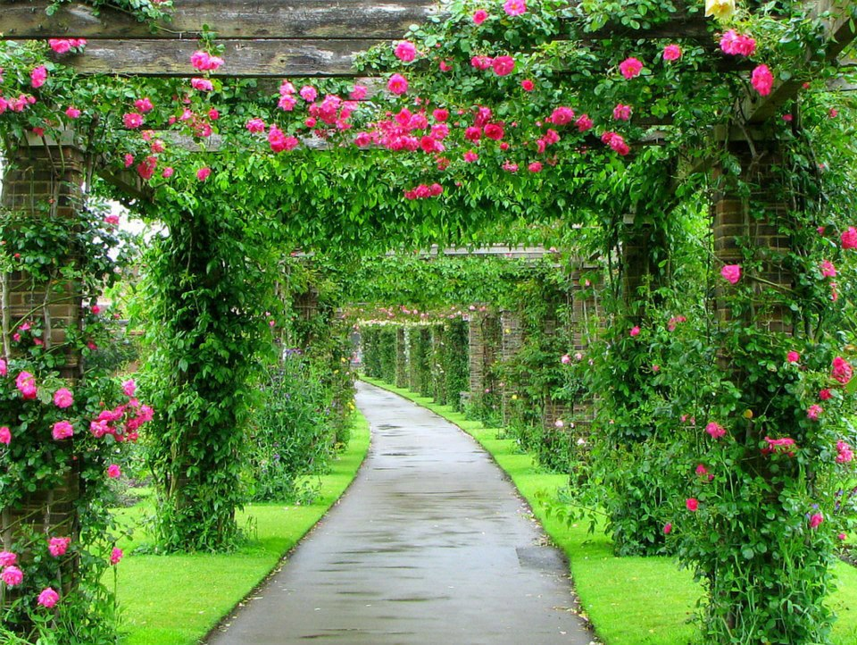

Slide 7
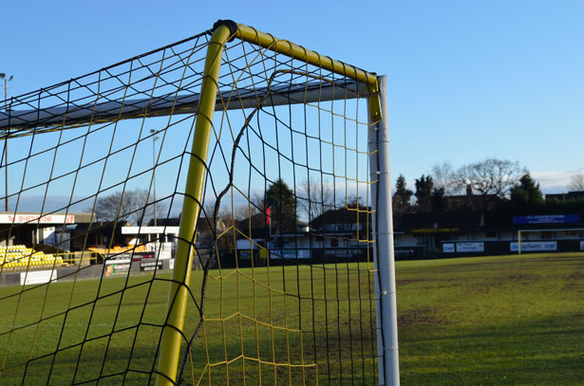

Slide 8
