Slide 1
Academic Heights Public School, Karad
2023-24
Grade X
Sub: History
Ln 2, Nationalism in India
A presentation by Ms. Priya Anandh

Slide 2
Nationalism in India - Checklist
1 The first world war – Khilafat & Non cooperation movement
2 Differing strands within the movement
3 Towards civil disobedience
4 The sense of collective belonging

Slide 3
Idea of Nation states (we find a boundary & its depicted as India)
During Monarchy there was not defined boundaries- fluctuating boundaries – people should have collective belongingness
Nation states – creates a common identity & belongingness
New symbols, icons, new songs & ideas (flag, National Anthem, feeling)
Point to develop nationalism was due to colonial rule.
Anti colonial sentiments started to emerge
People wanted to be free & the Great Revolt of 1857 was a spark of mutiny
The notion of Freedom for each class & group - peasants to jamindars
People were united to fight against Britishers

Slide 4
1. First world War & Impact of Nationalism
First world War took place 1914-1918 – created new economic & political impact
Defence expenditure hiked for the Britishers – fulfilled by increasing taxes & loans
When taxes increased – price of essential commodities increased ( food crops, clothing) – prices were doubled in 1913-1918
Impact – extreme hardships for common man – influenza – epidemic - famines
During WW 1 – soldiers were needed – forced recruitment – caused widespread anger
Crop failure- shortage of food – Britishers - Diverted food grains to Europe
Emergence of new leaders with new mode of struggle

Slide 5
The idea of Satyagraha & its Application
Mahatma Gandhi arrived in India January 1915 – returned from South Africa – brings an ideology – fought against racial discrimination – movements were based on Satyagraha.
Novel method of agitation & protest based on truth and non-violence was known as Satyagraha.
Satya – truth / agraha – to hold firm (truly engaged)
Philosophy- if the cause is true, struggle is against injustice then physical force is not required to fight against the oppressor. Oppressor should be persuaded to see the truth instead of being forced to accept truth through the use of violence. – soul transformation

Slide 6
Experiments conducted by Gandhiji
Champaran 1916 (Bihar) – Indigo Plantation – met Dr. Rajendra Prasad
  Britishers forced farmers to cultivate indigo & sent Indigo to their countries
  Quality of soil worsened
  Artificial indigo – synthetic dye produced
  Britishers asked the people to stop indigo cultivation
  Compensation by Britishers were less
  Gandhiji supported and got a little more of compensation
  Gandhiji’s first victory against Britishers.
  2. Kheda Gujarat – Peasants affected by crop failure – 1916 – met Sardar Vallabhai Patel
  Crop failure
  Tax could not be paid
  Plague broke out
  3. Ahmedabad - 1918
  Movement against cotton mill owners
  Supported workers to get more compensation

Slide 7
1 (i)Rowlatt Act
Britishers passed an act stating that Political prisoners could be detained in prison for two years without any trial.
After 2 years trial will be conducted – unjust law
Gandhiji opposed this unjust law through Satyagraha
6th April 1919 decided for Hartal / satyagraha
It marked first non-cooperation movement
This movement was against the Britishers in an organsied way – Rallies, strikes, protest
10th April 1919, Britishers fired on peaceful procession at Amritsar – proved people to take up violence – attacked police station

Slide 8
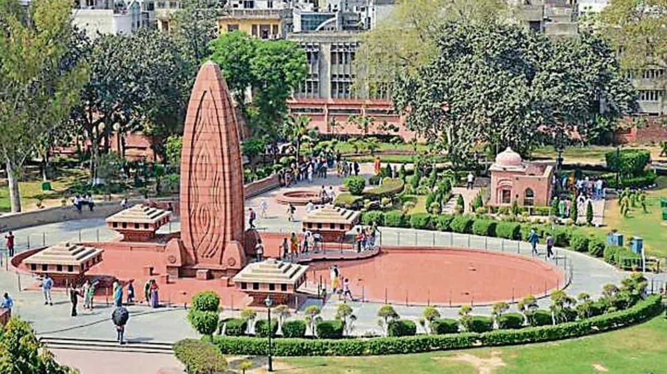
1 (II) Jallianwala Bagh Massacre
Violence broke out from Rowlatt Act
Martial law was imposed- curfew
On 13th April people gathered in Jallianwala Bagh - reason was Baisakhi fair – harvest festival & few came to protest– curfew was imposed
General Dyer commanded to close the exit door – fired people
Many people died few jumped in to the well

Slide 9
1 (iii) Khilafat Movement
Khalifa was the spiritual leader of Islam – Ottoman empire’s King– present day Turkey
Defeated in World War I
Rumours spread that peace treaties will be signed – unjust law may be passed
Disrespect of Muslims – Muslims were angry
Muslim masses protested against British due to rumours spread on peace treaties.
March 1919 – Mohammed Ali & Shaukat Ali , Mahatma Gandhi - Khilafat movement
Unity of Muslims & Hindus could be done.

Slide 10
Non Cooperation Movement
Calcutta session – September 1920 to start Satyagraha against Khilafat Issue
Gandhiji mentioned in his book Hind Swaraj “ The British rule in India is due to the cooperation of Indians only
Gandhiji proposed a stage by stage strategy
1. The movement began with a surrender of titles, honours & honorary posts by people.
2. Planned to boycott civil services, Army, Police, British courts & Legislative assemblies, school & colleges, British goods
3. The British goods to be replaced by Domestic goods or swadeshi movement to promote cottage industries
4. In case of Govt. suppression Civil Disobedience Movement will be launched.
5. After a lot of struggle the Non cooperation movement was adopted by the congress during the Nagpur conference in December 1920.
6. Under Mahatma Gandhi’s leadership Khilafat movement began in full force.
Nagpur session of congress in 1920 it was accepted.

Slide 11
2. Differing strands within the movement
1.Movement in the Towns
Many people participated in the movement but they had different motives to participate
Middle class participation – students left schools, colleges, Universities & teachers boycotted teaching, lawyers boycotted courts,
Justice party – Madras – party of Non- Brahmans – they refused to boycott elections – felt that gain power due to participating in election
2. Effect on Economy:
  Foreign goods boycotted, liquor shops picketed
  People threw foreign clothes into fire
  1920-22 import fell to 50% - 102 crore went to 57 crore
  Production of Indian textile increased

Slide 12
Limitations
  Impact of NCM began to slow down in towns
  Khadi clothes were expensive than mass produced mill clothes
  Indigenous Industries were less
  Absence of alternative industries
  Absence of alternative Indian Institutions later they went to study & teach
  Benares Hindu University developed during this time – Pandit Madan Mohan Malaviya established it

Slide 13
2.2Non Cooperation Movement in country side
Participation by peasants & Tribals
In Awadh (UP Province) Baba Ramchandra ( saint who was indentured labour in Fiji) led the peasants against Talukdars & landlords who levied excess rents & ceased their lands , abolition of Begar (forced labour/ bonded labour)
British took people to West Indies, Fiji to work in coffee, tea, rubber plantation in their island colonies.
Social boycott of oppressive landlords – atrocities
Nai-dhobi Bandhs
Awadh Kisan Sabha formed by Jawahar Lal Nehru & Baba Ramchandra – 300 branches established – set up a base

Slide 14
Nehru went to villages & developed support with peasants
Limitation : peasant movement made congressmen made unhappy – they adopted violent methods – bazaars were looted - talukdars & merchants attacked them
The name of Mahatma Gandhi was invoked in this – wrong interpretations by people
Participation by Tribals
In Gudem Hills, AP militant guerilla movement kicked off in 1920 - when forces are less they were invited in forest & attack would be conducted.
Strict forest policy of colonial people (restricting their livelihoods& traditional rights ) & it enraged them
Induced Begar system ( utilized them in railways & roadways construction)

Slide 15
Alluri Sitaram Raju
Belonged to Tribal community
Claimed to have special power
Rebels proclaimed that he was incarnation of God
He supported Gandhiji
Inspired by NCM
Persuaded people to wear Khadi
Gave up drinking
He believed that violence will fetch freedom & executed in 1924

Slide 16
2.3NCM Plantation fields
Plantation workers had their notion of swaraj
Saw -NCM in a different perspective
Independence for Plantation workers were that they can move freely in & out of the confined space.
Inland Emigration Act 1859 stated – people were not allowed to go out of the field without permission of the British – rarely they were permitted.
When NCM started to leave plantation field due to entry of Gandhiji – give independence to them – Gandhiraj was coming, thought people will be given land in their own villages- police caught them – beaten badly – railways & steamers were on strike.
Yet the nation were different but created an emotion to all India agitation
Shouted slogans on “Swatantra Bharat”.
Calling off- NCM – Chauri Chaura near Gorakhpur (UP,1922) – peaceful protest – police opened fire- protestors burnt police station – called off the NCM – people need to be trained

Slide 17
3. Civil Disobedience Movement
1922- Gandhiji called of NCM
Due to call of NCM - Leaders within congress party wanted to participate in provincial elections (Motilal Nehru & Chittaranjan Das) reason – to oppose the laws which the Britishers were taking within the council – demonstrate /reforms
Swaraj Party – to participate in elections
New leaders emerged - Jawaharlal Nehru, Subhash Chandra Bose ( young & radical leaders) they opposed they had different notion
2 factors shaped in Indian politics
  World economic depression
    Agricultural prices fell from 1926 & collapsed in 1930
    1930 the countryside was in turmoil.

Slide 18
    People were unhappy with Britishers
    Formation of Simon commission 1928 – headed - Sir John Simon – sent from Britain govt. from Tory govt.
      To frame constitution in India
      Greeted with a slogan “Go back Simon”
      Reasons for opposition
        No Indian member in it.
        Muslim league also joined
        Viceroy – Lord Irwin – offered dominion status & round table conference to discuss upon the making of Constitution in 1929
        Power to self rule( have own rulers/PM) – autonomy – but will stay under Britain
        Leaders like Nehru & Bose refused the offer & wanted Full independence gained importance –
        1929 Lahore session – president of the session – resolution was passed - poorna swaraj (full independence) MAP question (Lahore – Pakistan)
        26th January 1930 was planned to celebrate as Independence Day but unfortunately could not
        Gandhiji wanted to start off NCM as it was resting from 1922-1930

Slide 19
3.1 The Salt March & the Civil Disobedience Movement
Salt was a commodity consumed by rich & poor which will unite them - Essential food item – necessity of the people – natural commodity –
Reason for salt march – Gandhiji sent letter to viceroy Lord Irwin – 11 demand – should be fullfilled by 11 March 1930 . On 12th March 1930 Gandhiji starts Salt March – had 78 volunteers marched 240 miles for 24 days - Sabarmati to Dandi (coastal town) - on his way he spoke to people about CDM ( to use non violent means) – Map question on Dandi
6 April reached Dandi - Violates salt law – boils sea water to make salt. From 7th April they also started CDM
Gandhiji said that cooperation will not be given & disobey the Britishers ( people refused to pay taxes, violated forest laws, common citizens protected reserve forests)

Slide 20
NCM | CDM
1.Hindus muslims united | They had conflicts due to religious organisations
2. Eg: Hindu Maha Sabha – Muslim League – Muslims They were united in congress but later they divided based on religion

Slide 21
Reactions by British
Indians were arrested
Khan Abdul Gaffar Khan – frontier Gandhi – people protested in Peshawar – Gandhiji was arrested - attacked offices , buildings
Gandhiji called off CDM because people adopted violent means a pact was signed between Gandhi-Irwin pact- 5th March, 1931 – Irwin negotiates & asks to participate in the 2nd Round Table Conference at London – Dec 1931- Gandhiji disappointed at the conference – returned to India - found leaders were arrested ( Nehru & Ghaffar Khan)– Bhagat Singh was hanged
Gandhiji relaunched Civil Disobedience movement. One year it worked later it lost its momentum.

Slide 22
3.2 How participants saw the Civil Disobedience Movement
People had different notions about independence, movement etc.,
Country side Town
Rich farmers/landlord 1. Industrial owner
Poor peasants 2.Industrial worker
3. Women
Rich Farmers/ Landlord:
  Trade downfall – low prices – revenue from peasants fell – agricultural prices fell – peasants could not pay taxes – people enraged & oppose the colonial govt.- due to high taxes they wanted purna swaraj
  2. Poor peasants
  High revenue levied by British – unpaid rent to landlords (they borrowed land & paid rent)
  They wanted to waive off rent to landlords - radical movements (socialism) – congress wasn’t supporting as they will lose the support of landlords

Slide 23
3. Industrial Owners: financier of Congress party –– 1914-1918 WW – 1 companies in Britain had a downfall – India had a growth of Industries –after 10 yrs – British levied lot of taxes – so Industrialists favoured CDM to - protection about import of foreign products - GD Birla – Purshottam Das Thakurdas were Industrialists who supported
Relaunch was not supported by industrialists & peasants
4. Industrial Workers – Opposite poles – workers – industrialists
Different thought by workers – adopted gandhian idea – boycotted foreign products – congress did not want to take workers with them
5. Women
1st movement where women came out & participated- followed gandhian ideas- manufactured salt – went to prison – felt as sacred duty – Gandhiji’s view – women to take care of family & educate their children- symbolic presence – women were not offered big posts -

Slide 24
3.3 Limitation of Civil Disobedience Movement
Caste Religion
Individual Ambedkar Gandhi Mohd. Ali Jinnah M.R.Jaykar
Group Vs Harijans Brahmans Muslim Vs Hindu
Views of congress about dalits were different
Felt that if untouchables were included the Brahmans will feel alienated
Gandhiji named untouchables as Harijan
Gandhiji felt that if dalits were alienated it would take 100 years for idependence
Dalits organized themselves about reserved seats in education, seats in election,
Conflicts between Brahmans & Dalits
Ambedkar organized Dalits ( depressed classed association) – demanded separate electorates - Gandhiji fast unto death against this. – they signed a Poona Pact sep 1932 – instead of separate electorate it became reserve constituency

Slide 25
Religion –
Group level –
Distress in groups
Eg: Hindu Maha Sabha –Muslim League – Muslims
They were united in congress but later they divided based on religion
Individual Jinnah – congress wanted to end with negotaitions over representation – separate electorate ( Muslim dominated areas – todays Pakistan, W.Bengal & Bangladesh)
M.R.Jaykar – opposed this – leaders were not united – representation failed
The success could not be achieved

Slide 26
4. Sense of collective belongingness (5M)
They had a experience of united struggle – fight against the Britishers
Cultural processes – history, fiction, folklore, songs, popular prints, symbols
Image of Bharat Mata – vande Mataram – Bakim Chandra Chatterjee
Abanindranath Tagore – printed image – looked like a saint – ascetic figure – calm & composed
Revive of folklore by Rabindranath Tagore
Natesa Sastri wrote a book called “ The folklore of southern India”
TRICOLOUR Flag
Red, Green & Yellow – 8 lotus representing 8 provinces
a crescent moon
Gandhi’s tri colour flag – reg -3 religions ( Hindu, Muslim & Christians) – self reliant - spinning wheel

Slide 27
Britishers distorted our History
Bal gangadhar Tilak tried to develop a pride & reinterpreted history
He cultivated a sense of belongingness among people

Slide 28
FAQ’s
Define Satyagraha, Rowlatt Act, Jallianwala Bagh, Khilafat movement, Begar, Swaraj party, Alluri Sitaram Raju, simon commission , awadh kisan sabha, poona pact, nai dhobi bandh, Gandhi Irwin pact
First world war 1 Impact
Events responsible for the NCM / Idea of NCM / idea of different groups (relgion/caste)
Civil Disobedience movement ( salt as a symbol / participation/govt/reactions)
Limitations of Civil Disobedience movement
Difference between NCM & CDM
Steps taken to create a sense of collective belongingness.

Slide 29


