Slide 1

NATIONAL EDUCATION POLICY, 2020
Implementing in CBSE Schools

Slide 2

Vision of the Policy
Develop an education system deeply rooted in Indian ethos which has the capability to provide high quality education to compete in the global world.
The curriculum and pedagogy must develop a sense of respect towards Fundamental Duties and Constitution of India and have a deep bond with the country.
Develop a sense of pride and respect for the country and be responsible for human rights, sustainable development, global well being thereby reflecting a truly global citizen.

Slide 3





Key Principles of NEP-2020
Emphasize Conceptual Understanding
Rather than rote learning and learning-for-exams
Unique Capabilities Recognizing, identifying them in each student.
Critical thinking and Creativity
To encourage logical decision- making and innovation
Continuous Review
Based on sustained research and regular assessment by educational experts.
Respect for Diversity & Local Context In all curriculum, pedagogy, and policy.
Equity & Inclusion
As the cornerstone of all educational decisions.
Community Participation Encouragement and facilitation for philanthropic, private and community participation.
Use of Technology
In teaching and learning, removing language barriers, for Divyang students, and in educational planning and management.

Slide 4
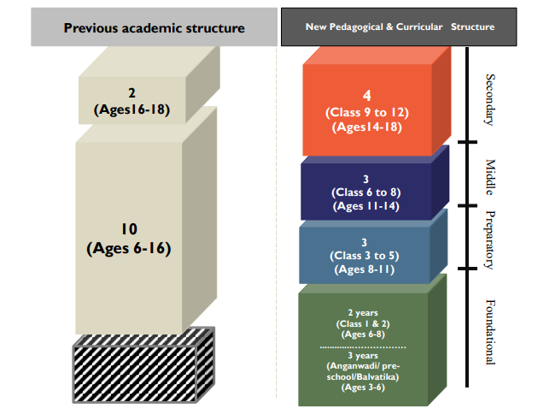
Transforming Curricular & Pedagogical Structure
New pedagogical and curricular structure of school education (5+3+3+4): 3 years in Anganwadi/pre-school and 12 years in school
Secondary Stage (4) Greater critical thinking, multidisciplinary study, flexibility and student choice of subjects
Middle Stage (3) experiential learning in the sciences, mathematics, arts, social sciences, and humanities
Preparatory Stage (3) play, discovery, and activity-based and interactive classroom learning
Foundational stage (5) multilevel, play/activity-based learning

Slide 5

Shift to Competency-based Teaching, Learning & Assessment
Promoting Critical and creative thinking aligned to the 21st century in classrooms
Shifting traditional assessments to competency focused
Track student progress comprehensively and frequently
Design tools and resources to acquire Learning outcomes
Reducing curriculum to the core essentials to minimise rote-learning
Promoting Sport-integrated & Art-Integrated Learning in Classroom for Holistic Development

Slide 6




SALIENT FEATURES OF STAGES IN SCHOOL
Foundational Stage
Play/activity-based learning
Pedagogy of Early Childhood Care and Education
Focus on good behaviour, courtesy, ethics, personal and public hygiene/cleanliness
Focus on teamwork and cooperation
Preparatory Stage
Gradual transition from play-based learning to more formal classroom learning
Interactive teaching-learning
Introduction of subjects, including, physical education, art, languages, science, and mathematics
Emphasis on reading, writing, speaking
Middle Stage
Subject-oriented pedagogical and curricular methodology
Subject teachers for learning/discussion of the more abstract concepts in each subject across the sciences, mathematics, arts, social sciences, and humanities
The High School (Secondary) Stage
Four years of multidisciplinary study
Greater depth, greater critical thinking, greater attention to life aspirations
Greater flexibility and student choice
Exposure to more subjects and enable greater flexibility
More frequent assessment of modules

Slide 7




Early Childhood Care and Education (ECCE) - The Foundation of Learning
Goals:
Ensuring that all children entering grade 1 are school ready by 2030.
Attain optimal outcome in the domain of physical and motor development, cognitive development, socio-emotional development, cultural/artistic development and the development of communication and early languages, literacy, and numeracy.
ECCE curriculum and pedagogy development
To prepare initial cadre of high quality ECE Teachers – plan to introduce 06-month certificate program in ECE, 01-year diploma program covering early literacy, numeracy and other relevant aspects of ECE – minimum qualification of teachers could be even 10+2 or above.
Introduction of a preparatory class (before class 1) for children of age 05-years – learning shall be based on play-based learning with a focus of developing -
Basic Mathematical Operations
Learn basic life skills
Read with Comprehension
Write

Slide 8

Attainment of Foundational Literacy And Numeracy by Grade 3 in Mission mode
Early Learning
Focus on early reading, writing & mathematics
Book Promotion
National Book Promotion Policy will be formulated and public and school libraries will be expanded
3-month Play based School
3-month play-based school preparation module’ for all Grade 1 students
National Repository
National Repository -High quality Teaching and Learning Resources on DIKSHA
National Mission
National Mission on Foundational Literacy and Numeracy
Libraries
School libraries, including digital libraries to be leveraged
Foundational Skills
Universal acquisition of foundational learning skills
Grade 3

Slide 9
Curtailing Dropout Rates and Ensuring Universal access to Education at all levels
To bring children back to school and prevent children dropping out the following steps will be taken-
Provide regular trained teachers at each stage, special care shall be taken to ensure that no school remains deficient on infrastructure support
Universal participation in school by carefully tracking students, as well as their learning levels, in order to ensure that they (a) are enrolled in and attending school, and (b) have suitable opportunities to catch up and re-enter school in case they have fallen behind or dropped out
Community partnership in terms of expertise and infrastructural support
Scope of school education will be broadened to facilitate multiple pathways to learning involving both formal and non-formal education modes. Open and Distance Learning (ODL) Programmes offered by the National Institute of Open Schooling (NIOS) and State Open Schools will be expanded and strengthened

Slide 10
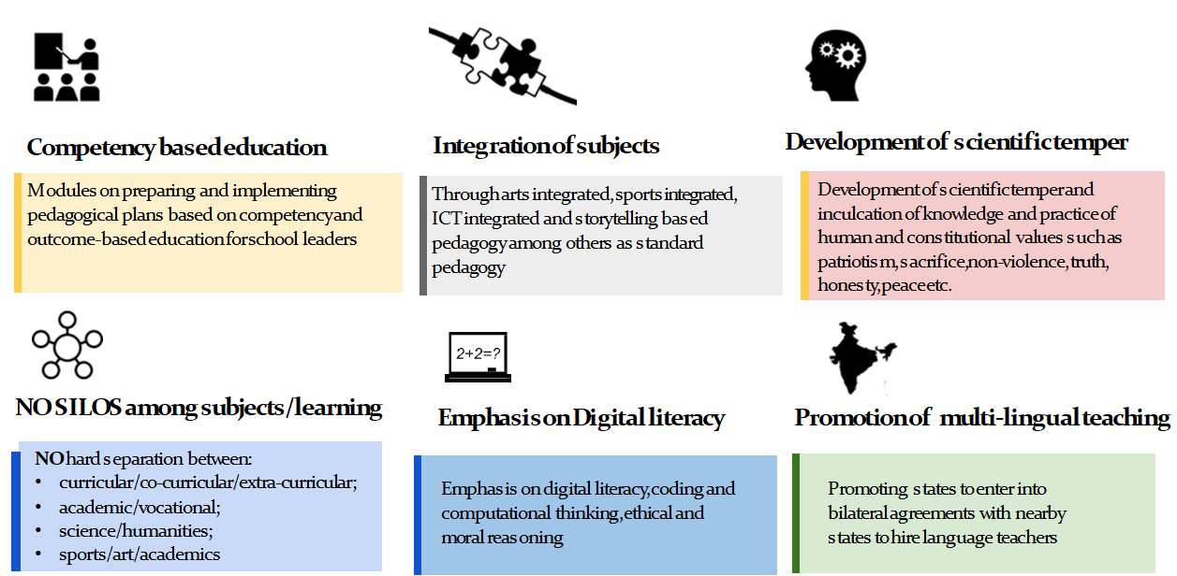
HIGHLIGHTS OF PEDAGOGICAL STRUCTURE

Slide 11












Encouraging 21st century skills in the classroom
Collaboration
Digital Literacy
Problem solving
Communication
Scientific Temper
Ethics
Critical Thinking
Social
Responsibility
Health & Fitness
Creativity

Slide 12
Introduction of Contemporary Subjects
Artificial Intelligence | Holistic Health | Data Science
Organic Living | Design Thinking | Machine Learning

Slide 13
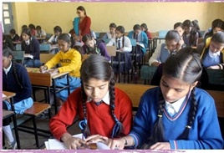
Year-long course during Grades 6-8
Survey and hands-on experience of a sampling of important vocational crafts, such as carpentry, electric work, metal work, gardening, pottery making, etc.
Decided by States and local communities and as mapped by local skilling needs

Slide 14

Mathematics and Computational Thinking
Increased emphasis throughout the school years, starting with the foundational stage
Use of a variety of innovative methods, including the regular use of puzzles and games that make mathematical thinking more enjoyable and engaging
Introduction of activities involving coding in Middle Stage

Slide 15


Emphasis on Vocational Education
10-day bag-less period during Grades 6-8 for students to intern with local vocational experts such as carpenters, gardeners, potters, artists, etc.
Internship opportunities to learn vocational subjects throughout Grades 6-12.
Vocational courses through online mode.
Periodic exposure to activities outside school through like meeting local artists and craftsmen
Vocational courses to be offered through Open and Distance Learning (ODL) mode
By 2025, at least 50% of learners shall have exposure to vocational education

Slide 16

Knowledge of India
Knowledge from ancient India and its contributions to modern India and its successes and challenges,
India’s future aspirations with regard to education, health, environment, etc.
Indian Knowledge Systems, including tribal knowledge and indigenous and traditional ways of learning and specific courses in tribal ethno-medicinal practices, forest management, traditional (organic) crop cultivation, natural farming, etc. will be made available.
An engaging course on Indian Knowledge Systems in secondary school as an elective.
Competitions in schools for learning various topics and subjects through fun and indigenous games.
Video documentaries on inspirational luminaries of India (ancient and modern) in science curriculum.
Students to visit different States as part of cultural exchange programmes
Constitutional Values will be developed in students. Excerpts from the Indian Constitution will also be considered essential reading for all students.
Knowledge of critical issues facing local communities, states, the country, and the world

Slide 17

Health Education
Basic training in health, including preventive health
Mental health and well-being
Nutrition
Personal and public hygiene and first-aid
Detrimental and damaging effects of alcohol, tobacco, and other drugs

Slide 18

Leveraging the power of Multilingualism and Language learning
Children whose primary language is not the language of instruction in school are more likely to drop out of school or fail in early grades
Mother-tongue/Home language/local language as medium of instruction, wherever possible, until at least grade 5 (preferably till at least grade 8)
‘The Languages of India’ a fun project/activity in schools to familiarize with the diversity of languages in the country

Slide 19

National Curriculum Framework for School Education (NCFSE) and
Text Books
The formulation of a new and comprehensive National Curricular Framework for School Education, NCFSE 2020-21, will be undertaken by the NCERT - based on the principles of this National Education Policy 2020 and will be made available in all regional languages.
All textbooks shall aim to contain the essential core material deemed important on a national level, but at the same time contain any desired nuances and supplementary material as per local contexts and needs.
Where possible, schools and teachers will also have choices in the textbooks they employ - from among a set of textbooks that contain the requisite national and local material.

Slide 20


Transforming Assessment for Student Development
Aim of Assessment
Shift from rote memorisation skills to formative, is more competency assessment
Promotes learning and development of students
Tests higher-order skills, such as analysis, critical thinking, and conceptual clarity.
Assessment for learning optimise learning and development for all students. This will be the underlying principle for assessment at all levels of education.

Slide 21






Transforming assessments and tracking student progress across school years
All students will take school examinations in Grades 3, 5, and 8
Key features of the assessment
Student data is anonymised, public disclosure by schools of their overall outcomes
Use data for continuous monitoring and improvement
Test core concepts and move away from rote memorisation
Conduct assessments for all schools (Govt.+Pvt.)
Conduct assessments for all schools (Govt.+Pvt.)
Grade 12
Grade 10
Grade 8
Grade 5
Grade 3
Achievement of basic learning outcomes, through assessment of core concepts and knowledge from the national and local curricula, along with relevant higher-order skills and application of knowledge in real-life situations, rather than rote memorization.

Slide 22
Redesigning Report Cards to assess Holistic development of each child
360 degrees Holistic Report Cards
The holistic progress card will form an important link between home and school and will be accompanied by parent-teacher meetings in order to actively involve parents in their children’s holistic education and development
Progress in project-based and inquiry-based learning
Quizzes, role plays, group work, portfolio, etc.
Self-assessment and peer assessment
Results of the School examinations
To be used only for developmental purposes of the school education
For public disclosure by schools of their overall student outcomes
Anonymized student outcomes
For continuous monitoring and improvement of the schooling system
Interactive questionnaires for Parents, Teachers & students
Teacher Assessment
Progress in cognitive, affective and psychomotor domains

Slide 23
Regarding Guidelines for Assessment
Guidelines will be prepared by NCERT, in consultation with major stakeholders, such as Boards of Assessment (BoAs), National Assessment Centre for School Education (NACSE) etc.
Transformation in the assessment system by 2022-23 academic session, to align with National Curriculum Framework for School Education (NCFSE) 2020-21

Slide 24
National Assessment Centre for School Education (NACSE)
This Centre will advise the school boards -
regarding new assessment patterns and latest researches,
for promoting collaborations between the school boards, and
to become an instrument for sharing of best practices between school boards, etc.
about shifting their assessment patterns towards meeting the skill requirements of the 21st century and in consonance with the stated objectives of this Policy

Slide 25


Teachers and Teacher Education NEP-2020
4 year Integrated
2 year B.Ed
1 year B.Ed
B.Ed
Minimum degree qualification for teaching that includes student- teaching at local schools, by 2030
For applicants with an existing Bachelor’s Degrees in other specialized subjects
For those who have completed the equivalent of 4-year multidisciplinary Bachelor’ s Degrees or have obtained a Master’ s degree in a specialty
All B.Ed. programmes will include training in time-tested techniques in pedagogy, multi-level teaching and evaluation, teaching children with disabilities, teaching children with special interests or talents, use of educational technology, and learner-centered and collaborative learning

Slide 26
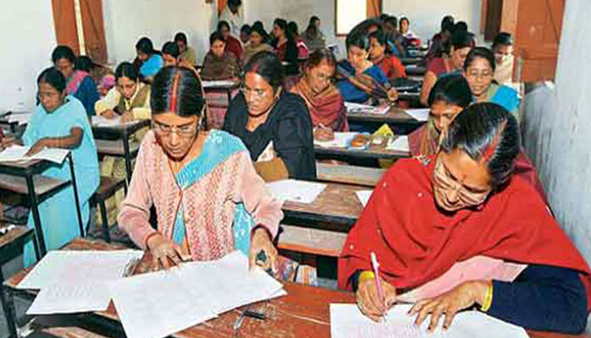
Teachers and Teacher Education NEP-2020
National Professional Standards for Teachers (NPST) will be developed by 2022.
The professional standards will be reviewed and revised in 2030 and thereafter every ten years, on the basis of rigorous analysis of the efficacy of the system.
Quality 4-year integrated B.Ed. Programmes
Transparency in transfers through online computerized systems
Teacher Eligibility Tests (TETs) will be strengthened.
Sharing of teachers across schools.
Schools/school complexes will hire local eminent persons/ experts as ‘master instructors’.
A technology based comprehensive teacher-requirement planning.
Teacher education will gradually be moved by 2030 into multidisciplinary colleges and universities
Multidisciplinary higher education institutions offering the 4-year in-class integrated B.Ed. Programm to also provide blended and or ODL mode of teaching to students in remote areas.

Slide 27



NEP aims to support and nurture Teachers through all phases of their tenure
1
2
3
4
Preparation
Recruitment
(Deployment, Transfer)
In the Classroom
Professional Development

Slide 28






Continuous Professional Development (CPD) & Improving Standards
Teachers will undertake 50 hours of CPD every year driven by their own interests
A new & comprehensive National Curriculum Framework for Teacher Education, NCFTE 2021, will be formulated
National Professional Teacher Standard (NPST) to set benchmark for expectations of the role of Teachers, standards for Performance appraisals and inform the design of pre-service Education
  Teacher Education to include aspects of supporting gifted children
  21-st century Teaching, Learning and Assessment will be at the heart of all Teacher training programmes
Training Teachers to be effective Online educators
  Anganwadi workers/teachers trained in early literacy, numeracy, and other relevant aspects of ECCE
Workshops and Training programs for development of School Leaders and Principals
Inclusion and equity will become a key aspect of teacher education & secondary specialisations to be created for Teaching kids with disabilities

Slide 29

Equitable and Inclusion Education NEP- 2020
Education is the single greatest tool for achieving social justice and equality.
NEP seeks to bridge gender and social category gaps in all levels of school education.
“Inclusive, good-quality education is a foundation for dynamic and equitable societies.”
~Desmond Tutu

Slide 30

Focus on Socio-Economically Disadvantaged Groups (SEDGs)
SE DG s will be formed and will be broadly categorized based on:
●
●
G e nder identities
(particularly female and transgender individuals),
Socio-cultural identities
(such as Scheduled Castes, Scheduled
Tribes, OBCs, and minorities),
●
Geographical identities
(such as students from villages, small
towns, and aspirational districts),
●
●
Disabilities
(including learning disabilities), and
Socio-economic conditions
(such as migrant communities, low
income households, children in vulnerable situations, victims of or children of victims of trafficking, orphans including child beggars in urban areas, and the urban poor).
Separate strategies will be formulated for f ocused attention for reducing each of the category-wise ga ps in school education.

Slide 31
How to ensure equitable and inclusive education?
Increased participation of SEDGs in the schooling system will be strengthened.
(SEZs) will be declared for educationally disadvantaged SEDGS.
A ‘Gender- Inclusion Fund’ for girls and transgender.
Free boarding facilities will be built
Inclusion and equal participation of children with disabilities in ECCE and the schooling system will also be accorded the highest priority.
Home-based education will be a choice for children who are unable to go to schools.
Teachers must be helped to identify such learning disabilities early and plan specifically for their mitigation.
Urgent need for additional special educators for certain areas of school education.
Alternative forms of schools, will be encouraged to preserve their traditions or alternative pedagogical styles.
Students in such schools would be encouraged to appear for State or other Board examinations and assessments by the NTA.
Special attention will be given to reduce the disparities for Scheduled Castes and scheduled Tribes.
Opening NCC wings in secondary and higher secondary schools will be encouraged
Students will be sensitized through this new school culture, brought in by teachers, trained social workers and counselors.
Human values such as empathy, tolerance, human rights, gender equality, non-violence, citizenship, inclusion and equity will be part of curriculum

Slide 32

Efficient Resourcing and Effective Governance through School Complexes/Clusters
To ensure-
adequate number of counselors/trained social workers and teachers (shared or otherwise) for teaching all subjects including art, music science, sports, languages, vocational subjects, etc;
adequate resources (shared or otherwise), such as a library, science labs, computer labs, skill labs, playgrounds, sports equipment and facilities, etc.;
a sense of community is built to overcome the isolation of teachers, students, and schools, through joint professional development programmes, sharing of teaching-learning content, joint content development, holding joint activities such as art and science exhibitions, sports meets, quizzes and debates, and fairs;
cooperation and support across schools for the education of children with disabilities; and
improved governance of the schooling system by devolving all finer decisions, to Principals, teachers, and other stakeholders within each group of schools and treating such a group of schools, which range from

Slide 33
NATIONAL EDUCATION POLICY, 2020
CBSE - Initiatives

Slide 34
Standard-setting and Accreditation for School Education
NEP 2020 on Standards Setting and Accreditation
A self-regulation or accreditation system will be instituted for all stages of - private, public, and philanthropic - to ensure compliance with essential quality standards
A minimal set of standards based on basic parameters (namely, safety, security, infrastructure, number of teachers, financial probity, and sound processes of governance), which shall be followed by all schools
States/UTs will set up an independent, State-wide, body called the State School Standards Authority (SSSA)
Dimensions and format of disclosure will be decided by the SSSA in accordance with global best practices
SCERT to develop a SQAAF: School Quality Assessment and Accreditation Framework through wide consultations
Key features of SQAA- for CBSE Schools
Self-assessment tool for schools to review their performance against pre-defined indicators/benchmarks
Easily implementable, transparent and objective tool
Focuses on enhancement of quality, recognition of excellence, promotion of accountability, and benchmarking schools across a range of descriptors or indicators of assessment
CBSE has developed a comprehensive framework termed as School Quality Assessment and Assurance (SQAA).The disclosure will be at the school level based on proficiency of school. Technical documents/standards has been prepared. E-portal for schools is being prepared. Piloted in the year 2021-22 and finally rolled out in the year 2022-23

Slide 35
Transforming Assessment and Examination
A Key Stage Assessment in class 3, 5 and 8-pilot in selected schools will be conducted in 2021-22
Holistic Report Card for CBSE schools is being prepared.
500 competency based test items for classes 1 to 5 related to the measurement of each learning outcome stipulated by NCERT; are being prepared
.
Work initiated on the development of Question Bank for Competency Based Items (HOTS)for classes 6-10 in major subjects. Will be available at DIKSHA
Training of Paper Setters and Moderators is going on to standardize Question Paper. 10 % higher order application oriented Source/Case based Questions till it becomes 60 %
CBSE has set up a Centre for Assessment. It will prepare standards linked to learning outcomes, Assessment Framework, Item Blueprints and Item development guidelines. Digital Assessment Unit is being set up.
A manual on Assessment 'As', 'For' and 'Of' Learning is being prepared.
Pilot will be done in the beginning of April/May 2021 or as and when schools reopen. It will be implemented on a larger scale in 2022-23. An online system is also being developed.
Pilot will be done in the beginning of April/May 2021 or as and when schools reopen. It will be implemented on a larger scale in 2022-23. An online system is also being developed.
Notes:
Task 35 –
Assessment of progress and achievements by students in FL&N will be at four levels (school-based assessment, SAS, third party assessment and NAS).
For the first level, that is, school-based assessments, a Holistic Progress Card will be designed by NCERT (for KVS/JNV/CBSE schools) for the foundational years.
Task 107 –
NCERT will prepare the framework and guidelines for developing Holistic Progress Card for Middle and Secondary levels.
Task 108 –
NCERT/PARAKH/CBSE/KVS/JNV/CTSA will contextualize and develop IT based solutions for online HPC for grades 1 to 12, for all CBSE schools.
Task 36 –
NCERT will continuously develop item banks for classes 1 to 5 related to the measurement or achievement of each learning outcomes.(at least 500 items per grade).
Task 103 –
For secondary education, CBSE and NIOS will prepare assessment pattern and evaluation procedures for its affiliated schools/students, so that it can be implemented from 2022-23 session onwards.

Slide 36
Initiatives for Capacity Building of Teachers
CBSE offers generic as well as subject specific Teacher Training programs. Same will be aligned to cater to the need of the newly recruited teachers. Induction programme will be initiated in the year 2022.
CBSE has its policy on in-service teacher training. This has been modified to make 50 hours mandatory CPD per year for teachers increasing it from the existing 35 hours.
CBSE will prepare small 10 minutes mock classrooms demonstrating a good class practice for experiential joyful learning, etc. The Board has introduced Experiential Learning, Competency Based Education, Art and Sport Integrated Education. All schools are mandated to follow Inclusive Education to provide conducive learning to all students.
The Board has published 36 manuals to handhold teachers and Trainings of teachers on newer pedagogies, classroom management, inclusive education and subjects using 32 Training Manuals developed by CBSE are being conducted.
Work is going on for developing five Foundational and Numeracy Training Modules which will be used for training teachers in online and blended mode.
Notes:
Task 32 –
NCERT, CBSE and KVS will develop online and blended teacher training modules and content as exemplar. This content will be used by Kendriya Vidyalayas for implementing the mission objectives.
Task 100 –
With the help of new Textbooks, NCERT and SCERTs should move towards developing MOOCs courses for each module of the entire syllabus by integrating 40% MOOCs courses in every grade in school education from class 6 to 12, so that school has more time to focus on arts, sports, vocational, languages, 21st century skills, etc.

Slide 37
Curricular Initiatives
01
02
03
    Art and Sports Integrated Education
    Principals as Pedagogical Leaders and Preparation of Annual Pedagogical Plans
    Implementation of Experiential Learning Pedagogies – like arts and sports integrated, story telling and gaming
04
05
    Mathematics and Hindi at two levels; English and Sanskrit will also be introduced at two levels from the session 2021-22
    Introduction of 9 vocational courses of 12 hour duration in classes VI-VIII in 2020
Notes:
Task 56 –
A National Book Promotion policy will be developed by NCERT. SCERTs will ensure adoption of the same in state/UTs through systematic inclusion in curriculum. Reading campaigns/competitions/spell-bees/fastest reader contests, etc. will be launched by states/UTs for promoting joyful reading amongst children.
Task 115 –
The NCERT will ensure that the NCF committee shall review the basket of subjects offered at secondary and senior secondary levels by CBSE and other BOAs, and ensure structured and relevant offering of academic and skill subjects.
Task 116 –
All subjects that do not fall within the parameters recommended by the NCF, will be discontinued by CBSE and other BOAs.

Slide 38
Ensuring Competency Based Education in Schools
Mandatory adoption of Learning Outcomes by CBSE Schools
Creative & Critical Thinking Practice Tests ; informal assessments through Student Enrichment Activities; and introduction of Case Based Questions in Question Paper Design
Mandatory Online Training on Experiential Learning and Competency Based Education
Development of Resource Material – Handbook on Experiential Learning; Teachers’ Resource for Achieving LOs; TERM
Notes:
Task 56 –
A National Book Promotion policy will be developed by NCERT. SCERTs will ensure adoption of the same in state/UTs through systematic inclusion in curriculum. Reading campaigns/competitions/spell-bees/fastest reader contests, etc. will be launched by states/UTs for promoting joyful reading amongst children.
Task 115 –
The NCERT will ensure that the NCF committee shall review the basket of subjects offered at secondary and senior secondary levels by CBSE and other BOAs, and ensure structured and relevant offering of academic and skill subjects.
Task 116 –
All subjects that do not fall within the parameters recommended by the NCF, will be discontinued by CBSE and other BOAs.

Slide 39




Student Enrichment Activities
Aryabhatta Ganit Challenge
Heritage India Quiz
EBSB Activities
CBSE Science Challenge
Science Exhibition
Khelo India
Expression Series
Reading Challenge
Notes:
Task 56 –
A National Book Promotion policy will be developed by NCERT. SCERTs will ensure adoption of the same in state/UTs through systematic inclusion in curriculum. Reading campaigns/competitions/spell-bees/fastest reader contests, etc. will be launched by states/UTs for promoting joyful reading amongst children.
Task 115 –
The NCERT will ensure that the NCF committee shall review the basket of subjects offered at secondary and senior secondary levels by CBSE and other BOAs, and ensure structured and relevant offering of academic and skill subjects.
Task 116 –
All subjects that do not fall within the parameters recommended by the NCF, will be discontinued by CBSE and other BOAs.

Slide 40
Expectations from Schools
Focus on core essentials/Learning Outcomes
  Focus on Foundational skills in lower grades. Map curriculum across grades and subjects with the defined LOs
  Focus on practical and application-based learning; experiential learning; and enhancing creative and critical thinking skills of students
  Enable teachers to design such experiential and application based activities which enhance the creative and critical thinking skills and other desired skills among the students
Stress on the importance of foundational skills of literacy and numeracy
  Transform teaching strategies or adopt innovative teaching strategies to develop, strengthen and achieve these foundational skills by grade 3. Focus at an early age on reading, writing, and learning of basic mathematical concepts.
3 Bring changes in classroom teaching in alignment with the NEP 2020
  Define/Adapt/Adopt Learning Outcomes and Link assessment with the defined LOs
  Adopt experiential learning pedagogies to achieve the defined LOs
  Integrate subjects and technology to create a holistic learning experience for students
  Integrate the component of digital literacy, scientific temper and computational thinking
  Plan lessons grounded in real-life situations and Plan to promote multilingualism
  Identify and nurture gifted students and plan for CWSN and SEDGs (socially emotionally disadvantaged groups) of students

Slide 41
4. Bring changes in the assessment pattern
  Adopt varied modes of assessment
  Focus more on assessment as and for learning
  Align assessment practices with the defined LOs and focus on achievement of desired competencies in students
  Carry out Holistic(360 degree) assessment of the student in cognitive, affective and psychomotor domains.
  Design/create multidimensional or holistic report card reflecting the uniqueness of each child in the cognitive, affective and psycho motor domains
  Plan to track learning of each child
5. Remove separations between subjects and disciplines
  Adopt holistic educational approach by removing hard separations between arts and sciences; curricular and co-curricular activities; academic and vocational streams
6. Vocational training to students
  As mentioned in the NEP, one bagless day can be planned for the hands-on learning of the vocational subjects.
  Popularise and offer vocational courses/training to students

Slide 42
7. Enable Access and Retention
  Track each child and ensure there are no drop outs
  Ensure educational access and retention of SEDGs
  Help each child to continue education through RTE Entitlements
  Involve all stakeholders in the child’s learning process and journey (parents, local administration etc.)
  Enhance and enrich student learning through innovative pedagogy
  Create safe and conducive environment for learning and teaching
  Maintain inclusive and clean infrastructure
  Monitor/Track Health status of Children through periodic health check–up
8. Self-Audit on School Quality Assurance and Accreditation Framework (SQAAF)
Disclose all financial, academic and operational matters as expected from schools by SSSA
9. Provide enabling resources both to students and teachers
10. Ensure that all students at all levels of school education are taught by passionate, motivated, highly qualified, professionally trained, and well-equipped teachers.
11. Recruit qualified teachers and as per NCTE regulations

Slide 43
    Ensure Capacity Building at all levels
Build capacities of School management, Heads, teachers, staff, parents, community/volunteers
Minimum 50 hours CPD per year for heads and teachers
Mentoring of teachers
NISHTHA needs to be compulsorily completed by all teachers
Training regular teachers to teaching some appropriate vocational subjects and training of vocational teachers
Train teachers in:
  Identifying/recognising and nurturing unique potential of every child
  Curriculum and pedagogy of ECCE/FLN
  Use of technology platforms such as SWAYAM/DIKSHA
  Basic health indicators to look out for and monitor in children
  Teaching Indian Languages
  Shift in teaching learning from rote to inquiry based, critical thinking, cognitive learning and applied methods
  Assessment as learning and Assessment for learning
  Implementation of Holistic Progress Card
  Creation of safe and secure learning environment in school
  Time-tested as well as new pedagogies

Slide 44
    Engage with parents and community for a positive learning environment
Inform parents about expected learning outcomes, portfolios, home assignments, etc.
Sensitize parents of children with physical and learning disabilities, first generation learners
Make home visits, if possible and necessary
Arrange workshops on parenting, and particularly on exam related anxieties and other stress
Engage with parents to deal with substance abuse, sexual orientations and other adolescence issues
Constantly send information about the activities in the school, and child’s progress
Send portfolios back to parents for review and feedback
Inform parents about what kind of assistance the child needs at home for learning
Newsletters, e-mails, blogs, memos etc. can be a regular feature
Let Parents be volunteers for FLN/field visits, sports/art exhibitions, annual function, school magazine, etc.
Exposure lecture by parent specialists - a counsellor, doctor, sportsperson, filmmaker, etc.
Have parent representatives for PTMs
Organise specific events only for parents
Involve parents in the community outreach work undertaken by the school.

Slide 45


