Slide 1
HOW TO TELL WILD ANIMALS BY CAROLYN WELLS
The topic of the distinctive attributes and characteristics of wild animals and how they differ from domestic animals is the theme of Carolyn Wells’ poem “How to Tell Wild Animals.” The poem jokingly enumerates many ways to distinguish wild animals from domestic ones, highlighting their untamed, independent spirits, and natural habits
In the poem, the poet has explained the characteristics of various wild animals in a very funny way. She has used language in a way that it generates humour. She is introducing the reader to various kinds of wild animals like Asian lion, Bengal tiger, bear, etc.explaining each of the animals in a very humorous way.

Slide 2
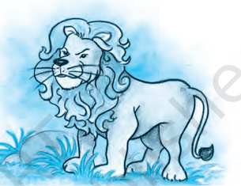
POEM :
If ever you should go by chance
To jungles in the east;
And if there should to you advance
A large and tawny beast,
If he roars at you as you’re dyin’
You’ll know it is the Asian Lion…
Word meaning : Tawny: yellowish brown color
Literary Devices :
Rhyme: Rhyme scheme ababcc is followed (chance-advance, east-beast, dyin-lion)
Enjambment: Continuation of a sentence to the next line (and if there…..tawny beast)
Inversion: Change in the format of a sentence (if there should to you advance)
Assonance: use of vowel sound ’o’ (you should go, should to you, roars,)
Allusion: Reference to a famous thing, place, species of animal, etc (Asian Lion)

Slide 3

Or if some time when roaming round,
A noble wild beast greets you,
With black stripes on a yellow ground,
Just notice if he eats you.
This simple rule may help you learn
The Bengal Tiger to discern.
Word meaning :
Noble: high born, aristocratic
Discern: recognize
Literary Devices :
Rhyme: Rhyme scheme ababcc is followed (round-ground, you-you learn-discern)
Alliteration: repetition of consonant sound ‘r’ at start of two or more closely connected words (roaming round)
Inversion: Change in the format of a sentence (The Bengal Tiger to discern)
Allusion: Reference to a famous thing, place, species of animal, etc (Bengal Tiger)
Assonance: Use of vowel sound ’o’ (or if some time when roaming round)

Slide 4
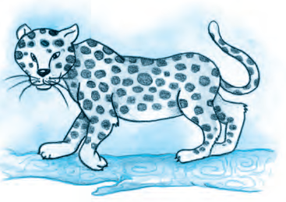
If strolling forth, a beast you view,
Whose hide with spots is peppered,
As soon as he has lept on you,
You’ll know it is the Leopard.
’Twill do no good to roar with pain,
He’ll only lep and lep again.
Word meaning :
Strolling: walking casually
Forth: forward
Hide: skin of animal
Peppered: Here it means the spots
Lept (Leapt): jump towards someone
Literary Devices:
Rhyme: Rhyme scheme ababcc is followed (view- you, peppered- Leopard, pain-again)
Alliteration: use of consonant sound ‘h’ in the beginning of two words (he has)
Poetic license: A liberty to the poet to change the spellings in order to create rhyme or rhythm in a poem (use of lept instead of leapt)
Repetition: use of ‘lep’ word in the last line.
Assonance: use of vowel sound ‘o’ (strolling-forth-you, whose-spot, do no good to roar)
Consonance: use of ‘l’ sound (he’ll only lep lep)

Slide 5
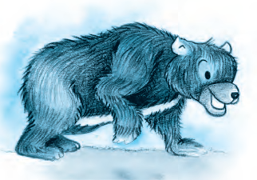
POEM :
If when you’re walking round your yard
You meet a creature there,
Who hugs you very, very hard,
Be sure it is a Bear.
If you have any doubts, I guess
He’ll give you just one more caress.
Word meaning :
Yard: backyard or the lawn area of a house
Caress: A gentle touch
Literary Devices:
Rhyme: Rhyme scheme ababcc is followed (yard-hard, there- bear, guess-caress)
Enjambment: Continuation of a sentence to the next line (if you were walking….creature there)
Alliteration: use of ‘w’ sound (when-walking), use of ‘h’ sound (who- hugs), use of ‘b’ sound (be-bear)
Assonance: use of vowel ‘e’ (meet a creature there)

Slide 6
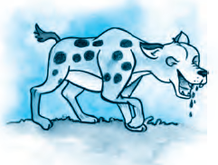
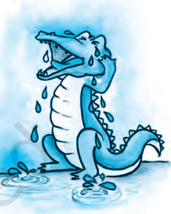
Though to distinguish beasts of prey
A novice might nonplus,
The Crocodile you always may
Tell from the Hyena thus:
Hyenas come with merry smiles;
Word meaning :
Distinguish: Differentiate
Beast of Prey: Any animals that hunts other animals for food
Novice: Someone new to a job
Nonplus: be confused
Literary Devices:
Rhyme: Rhyme scheme ababcc is followed (prey-may, nonplus-thus, smiles-crocodiles)
Alliteration: use of consonant sound ‘n’ (novice-nonplus), use of ‘th’ sound (the-thus)
Enjambment: continuation of sentence to the next line (though to distinguish….might nonplus, The crocodile…..hyena thus)

Slide 7
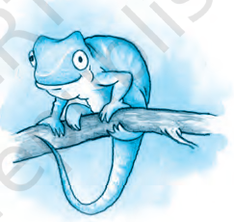
The true Chameleon is small,
A lizard sort of thing;
He hasn’t any ears at all,
And not a single wing.
If there is nothing on the tree,
’Tis the chameleon you see.
Literary Devices :
Rhyme: Rhyme scheme ababcc is followed (small-all, thing-wing, tree-see)
Alliteration: use of ‘h’ sound (he hasn’t)
Consonance: use of ‘g’ sound (single wing)

Slide 8
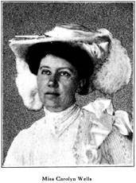
Carolyn Wells (1862-1942) was a prolific American author and poet known for her diverse body of work, including children's books, humorous verse, and mystery novels. She was particularly successful in the mystery genre, writing over 170 books in her lifetime.
Wells was born in Rahway, New Jersey, and faced personal challenges including partial deafness from scarlet fever. Despite this, she pursued her passion for writing, contributing to small literary magazines before gaining recognition for her work.
Her early career focused on children's literature, humorous verse, and poetry. She is remembered for collections like "A Nonsense Anthology" (1902) and "The Book of Humorous Verse" (1920). Later, she became captivated by mystery novels and shifted her focus to that genre. Some of her notable mystery works include "The Gold Bag" (1911) and "Vicky Van" (1918).
Carolyn Wells's writing style was characterized by wit and cleverness, and she was a significant figure in American literature, leaving behind a legacy of over 170 published works.

