Slide 1
Interpretation of survey map
Interpretation of survey map
Part I
  GRID REFERENCE
  SCALES
  MEASURING AREA & DISTANCE

Slide 2
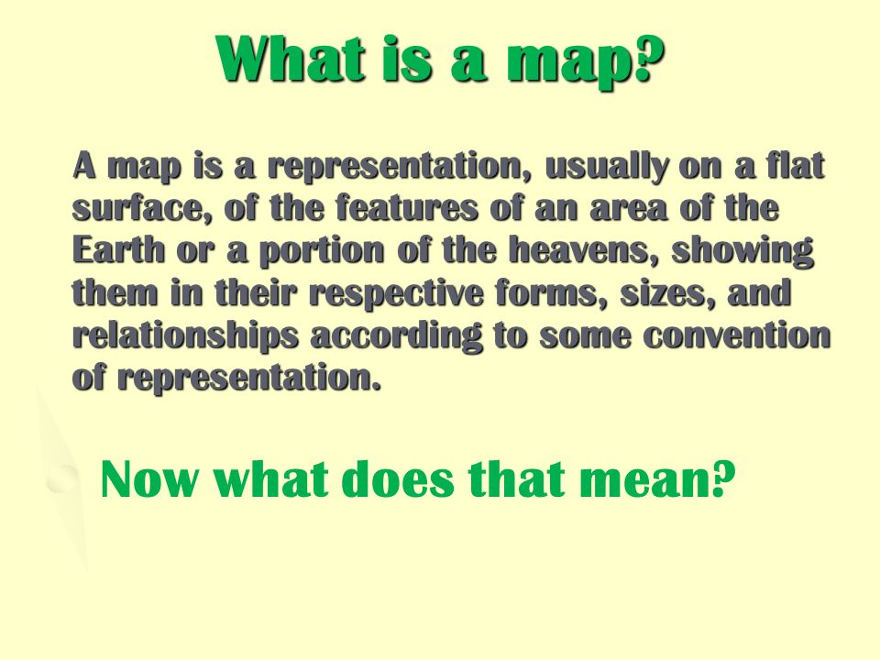

Slide 3
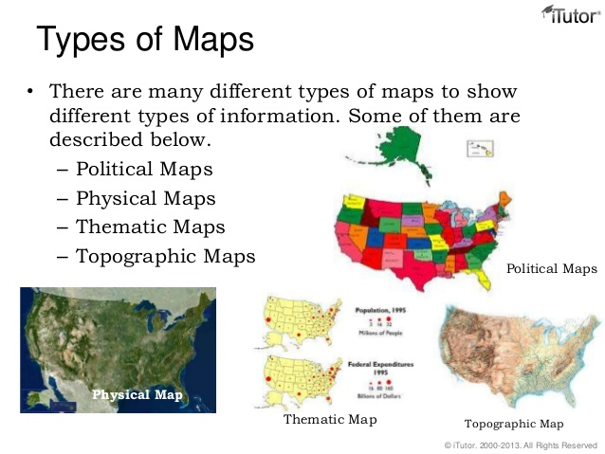

Slide 4
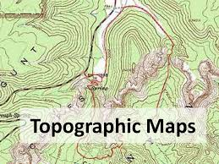
Topographical Maps
Topography – ‘the shape of the earth/land surface.
Topographical maps are large scale maps that show in detail the natural and the cultural or man made features of an area. These maps are drawn on large sheets and are known as toposheets.

Slide 5
Features shown on a topographical map are:
Relief: mountain, valley, cliff, plain, plateau
and depression.
Water bodies Lake, river, streams, swamps
Vegetation Wooded/ forested and cleared areas,
reserved and protected forests,
cultivated areas
Cultural/ towns, village, roads, railways,
human made airport, well, post office, police station
and places of worship
–
Boundaries teshil, district, state, national and
international.

Slide 6
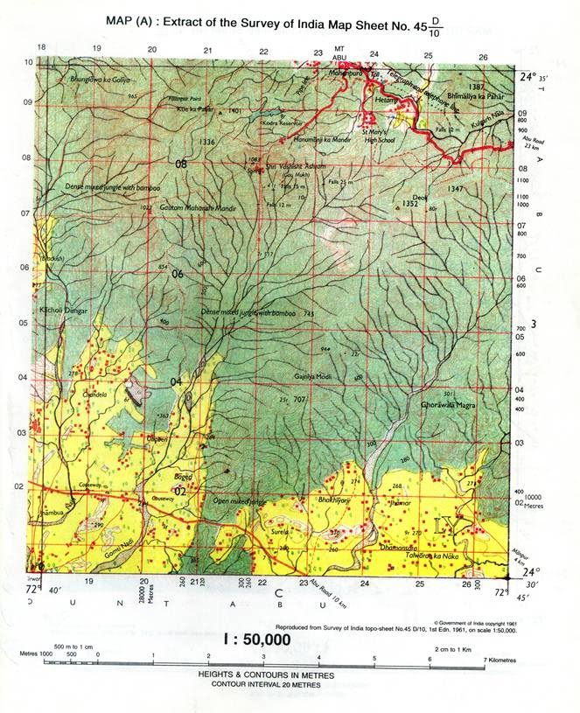

Slide 7
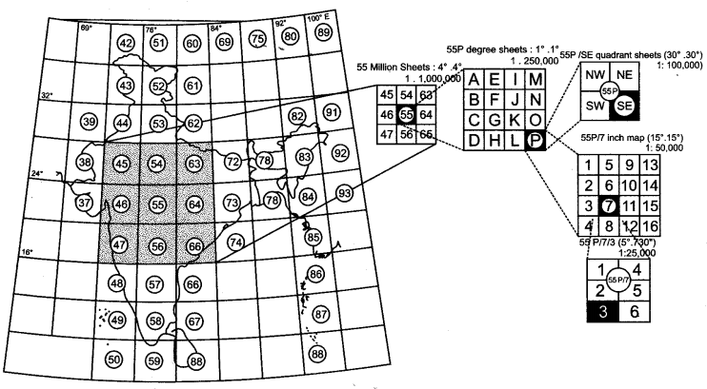

Slide 8
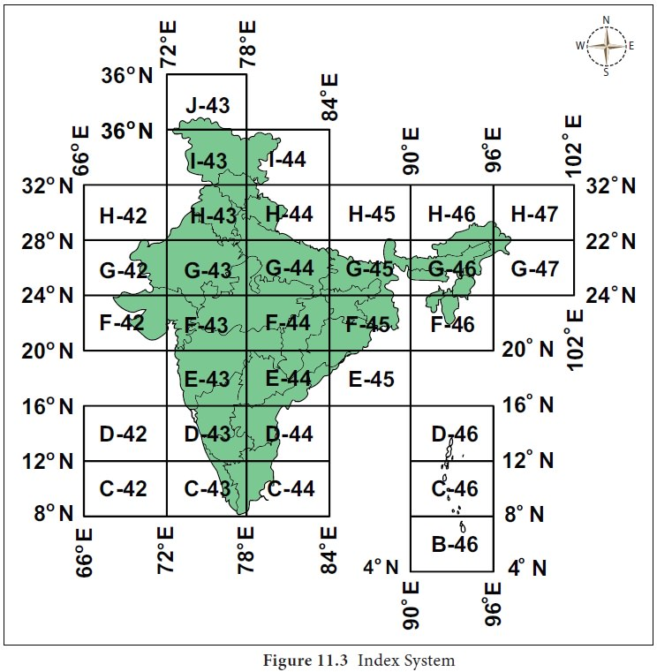

Slide 9
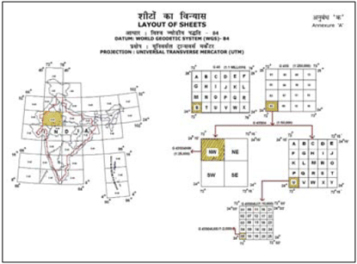

Slide 10
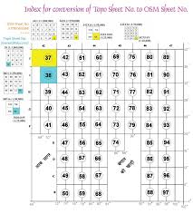

Slide 11
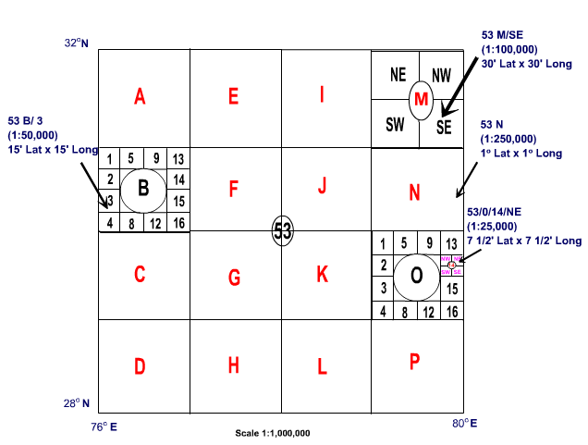

Slide 12
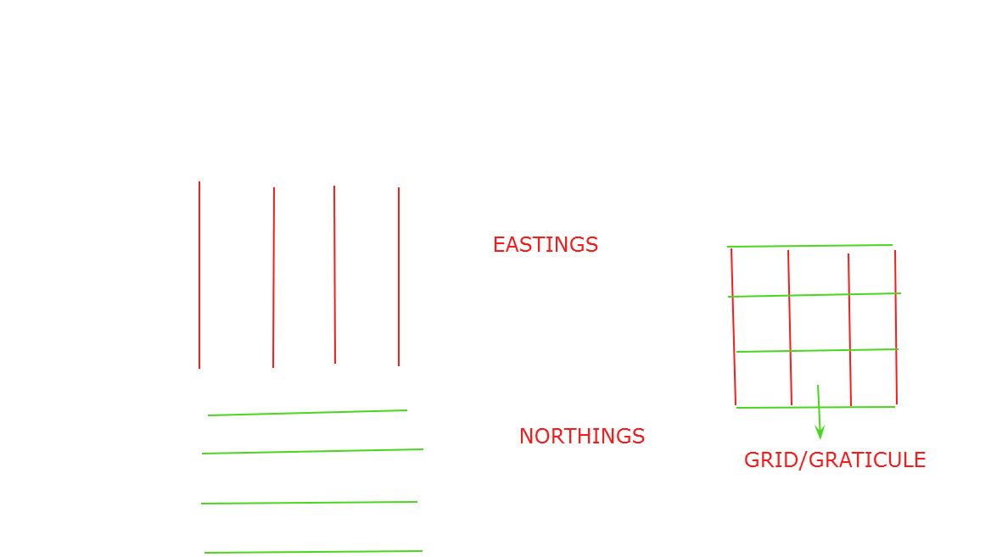

Slide 13
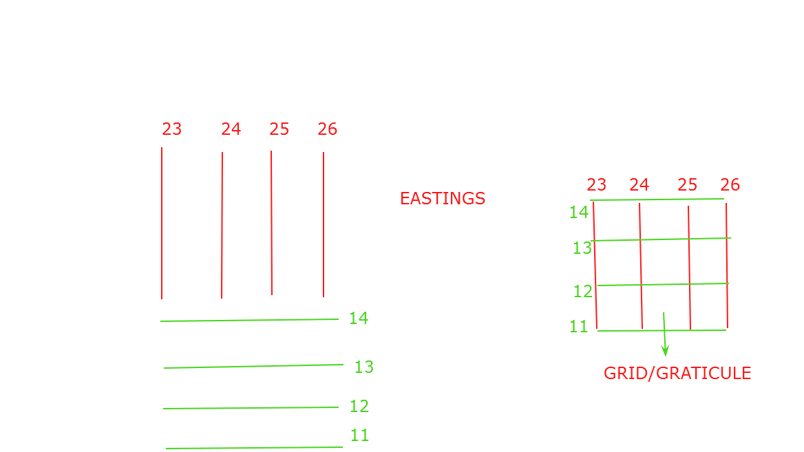
NORTHINGS

Slide 14
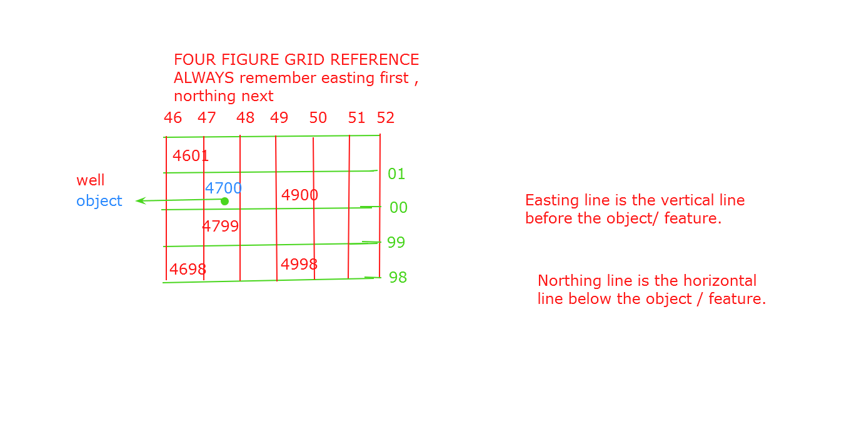

Slide 15
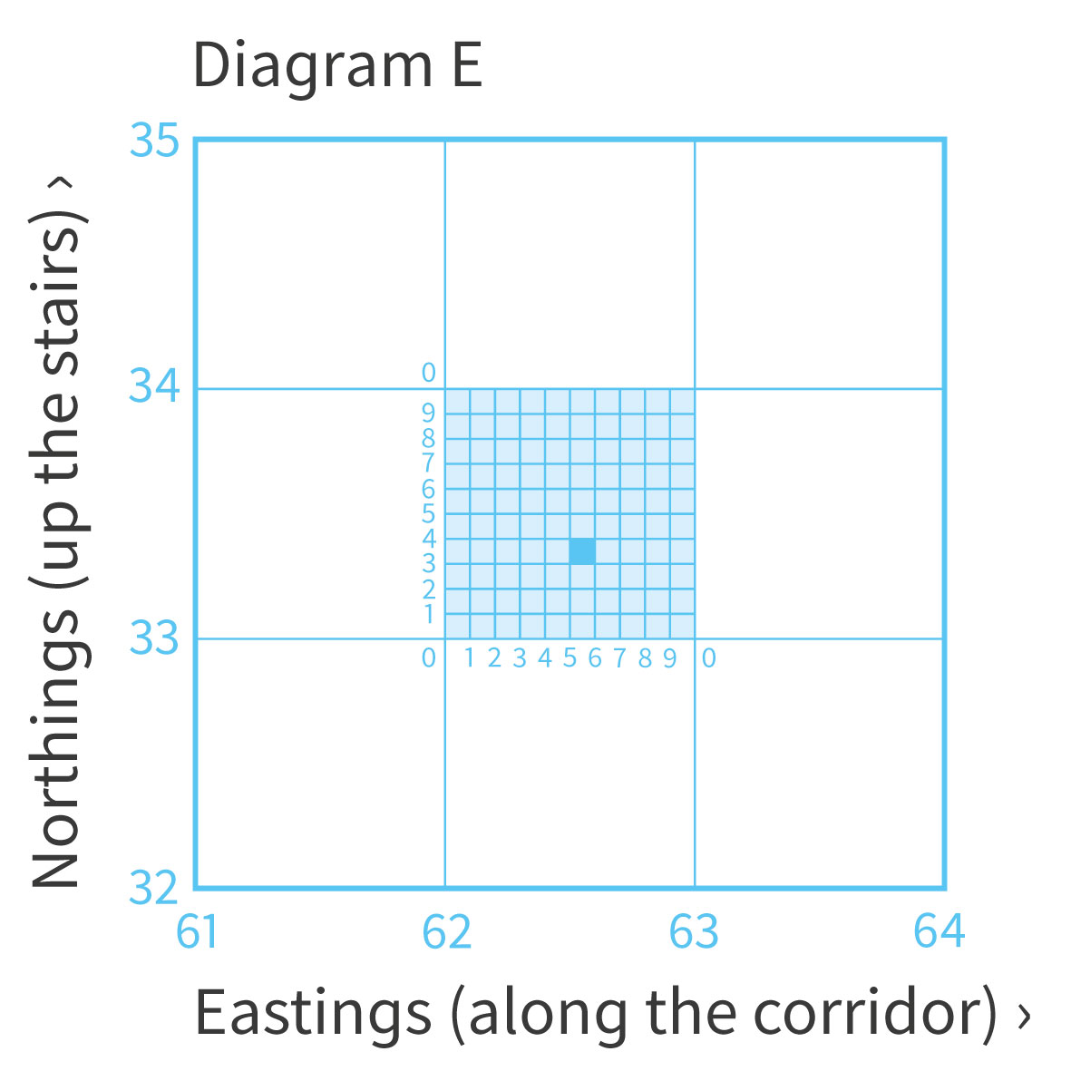

Slide 16
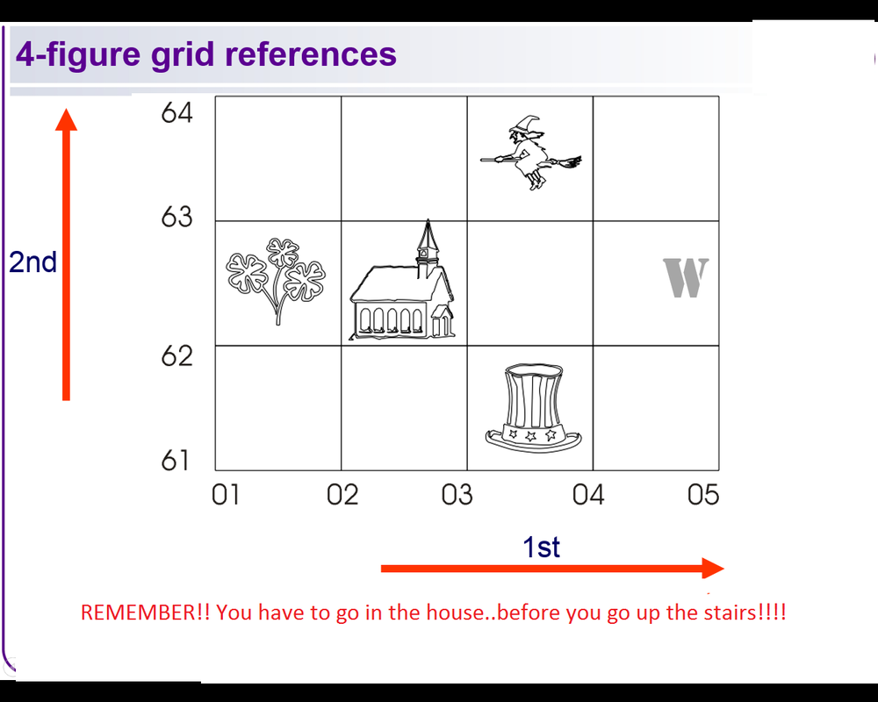

Slide 17
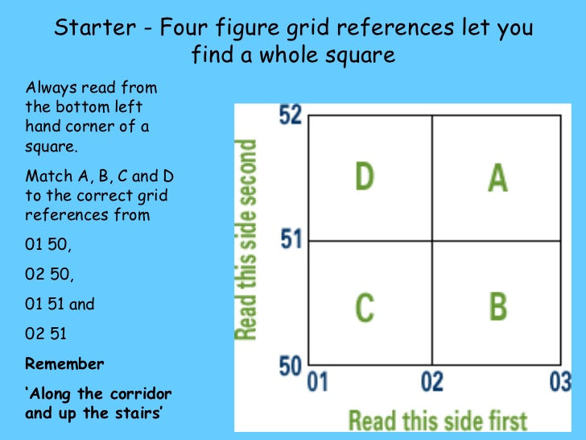

Slide 18
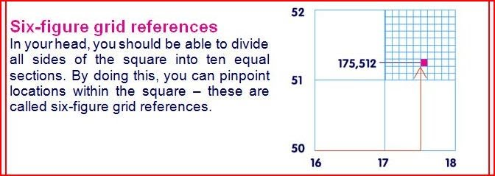

Slide 19
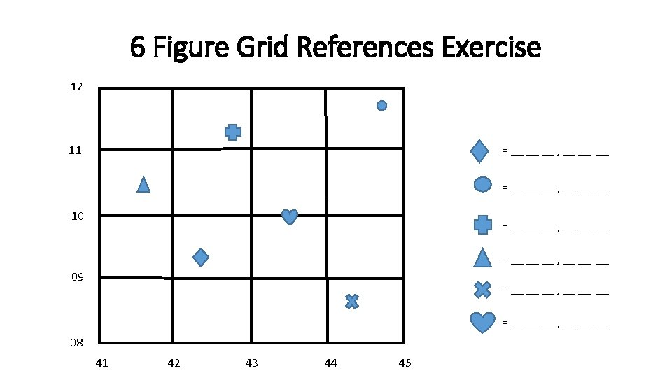

Slide 20
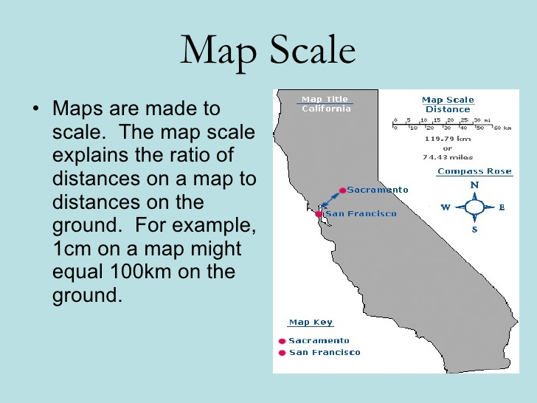

Slide 21
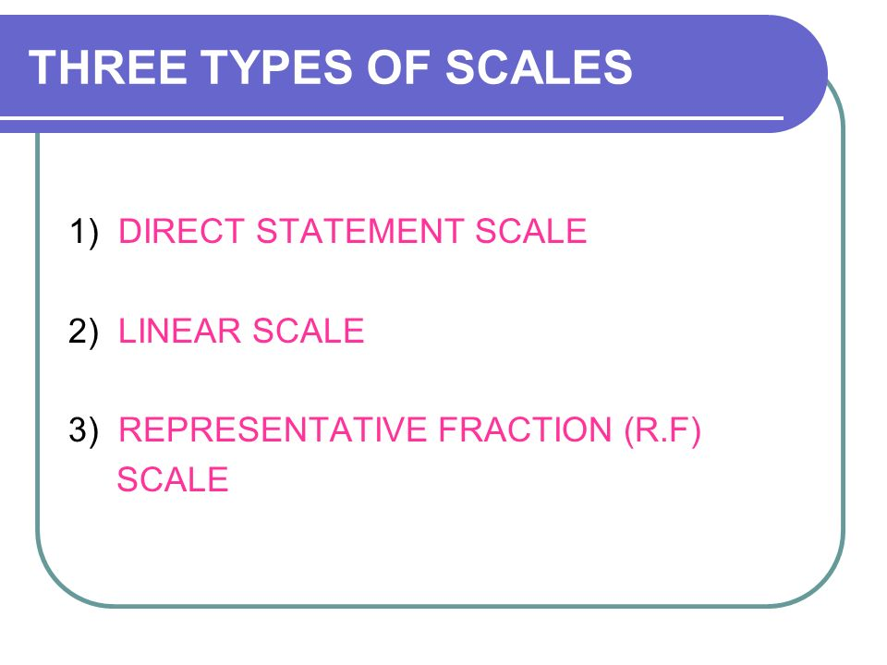

Slide 22
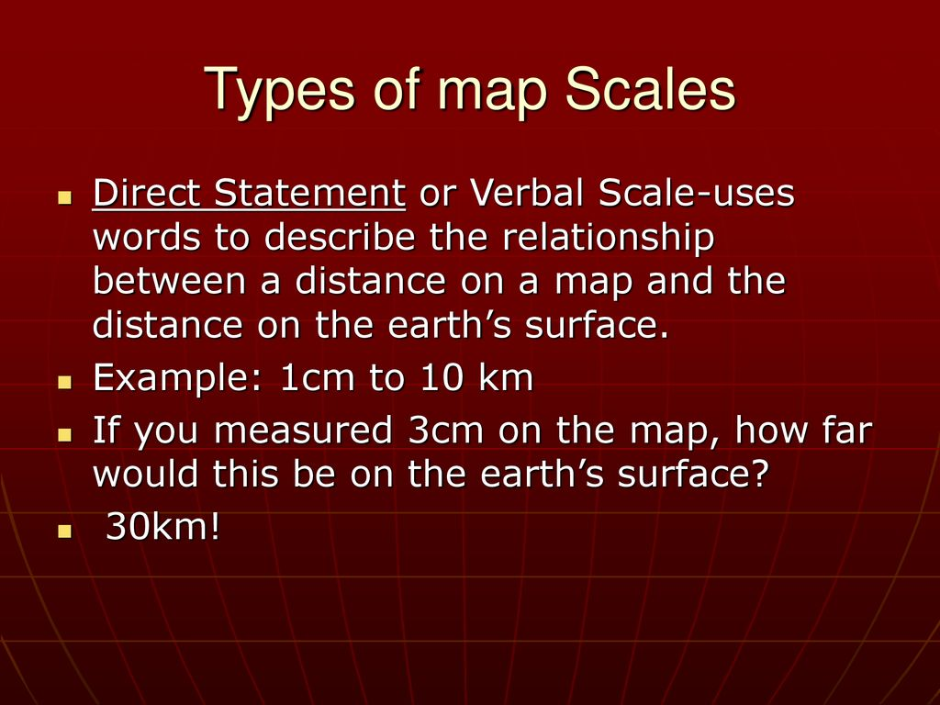

Slide 23
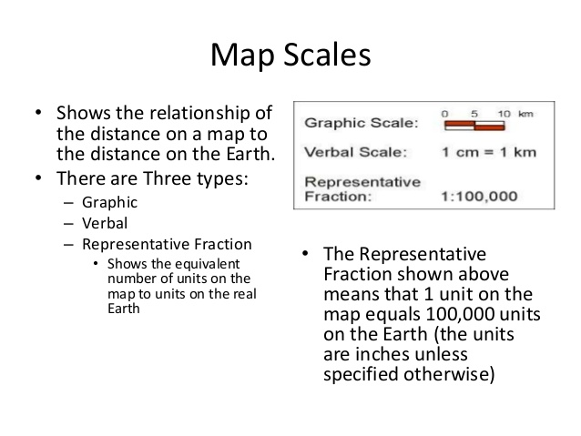

Slide 24
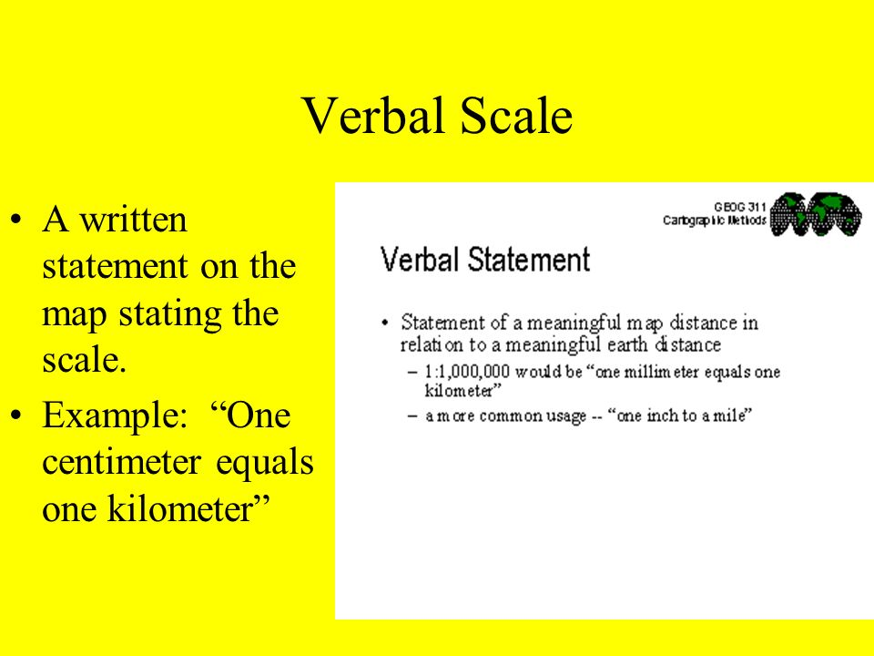
VERBAL SCALE/
STATEMENT SCALE
A verbal scale expresses the relationship between distance on the map and distance on the actual ground.
for example,’1’cetimeter represents 5 kilometers
’means that 1 cm on the map represents 5 km on the actual ground.

Slide 25
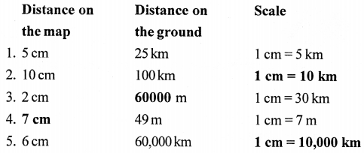

Slide 26
REPRESENTATIVE FRACTION
A representative fraction indicates ratio between the number of units on the map to the number of units on the ground.
Representative fractions are a unit-less relation between one “unit” on the map and how ever many “units” of the same type on the ground.
An RF of 1:24,000 means one inch on the map equals 24,000 inches on the ground and one centimeter on the map equals 24,000 centimeters on the ground.

Slide 27
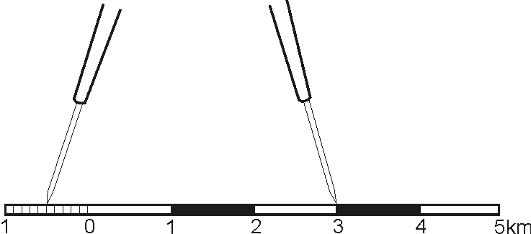
GRAPHIC OR LINEAR SCALE
A graphic scale visually expresses the scale of the map. It consists of
horizontal line with equal division marked on it. The length of each unit shows
how many kilometers or mile each unit is equal to on the ground.
The graphic scale has two parts.
The part of the right of the zero is called the primary scale, it shows the full units of measure (for example, kilometers or miles)
The part to the left of the zero is called the extension scale

Slide 28
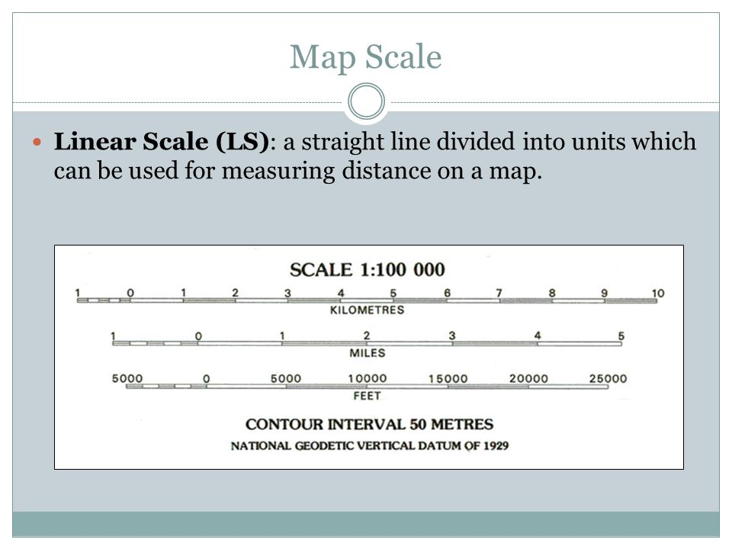

Slide 29
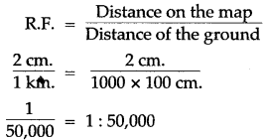
CONVERSION OF STATEMENT SCALE INTO RF SCALE
Ex 1 - CONVERT THE STATEMENT scale 2CM TO 1KM INTO RF SCALE

Slide 30
Calculation of Area
•Area= Length x Breadth
•In topo maps, each grid (square) 2cm X 2cm or
1 km to 1 km as per the scale 2 cm=1 km
•Therefore , area of each square is 4 sq cm (on the map)
= 1 sq km (on the ground)
In metres, this can be expressed as
Area of each square (i.e. 4 sq cm) = 1000 X 1000
or 1,000,000 sq m.

Slide 31
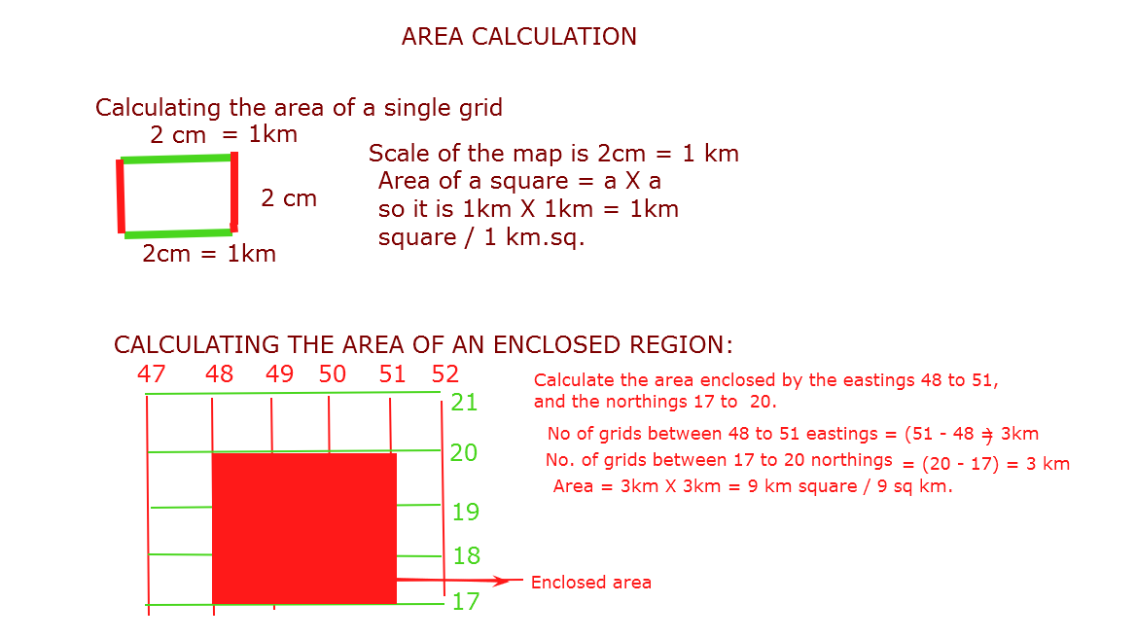

Slide 32
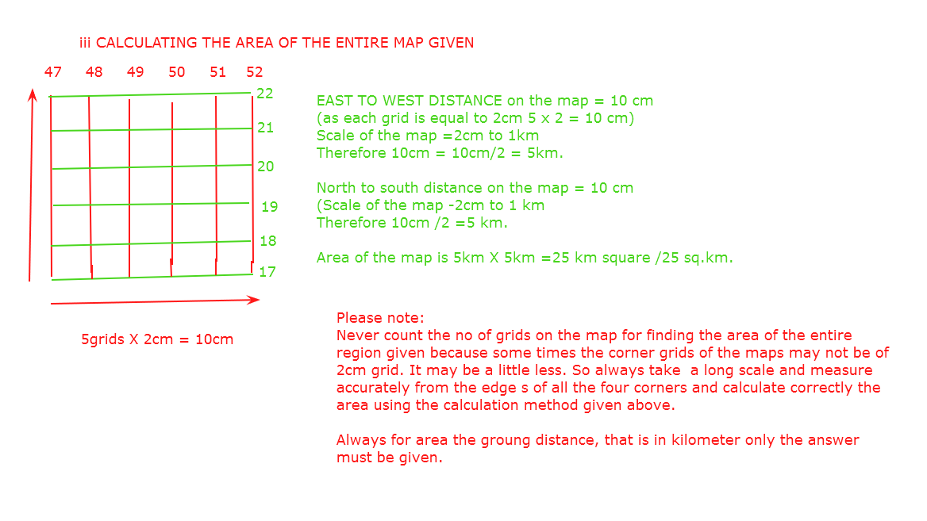

Slide 33
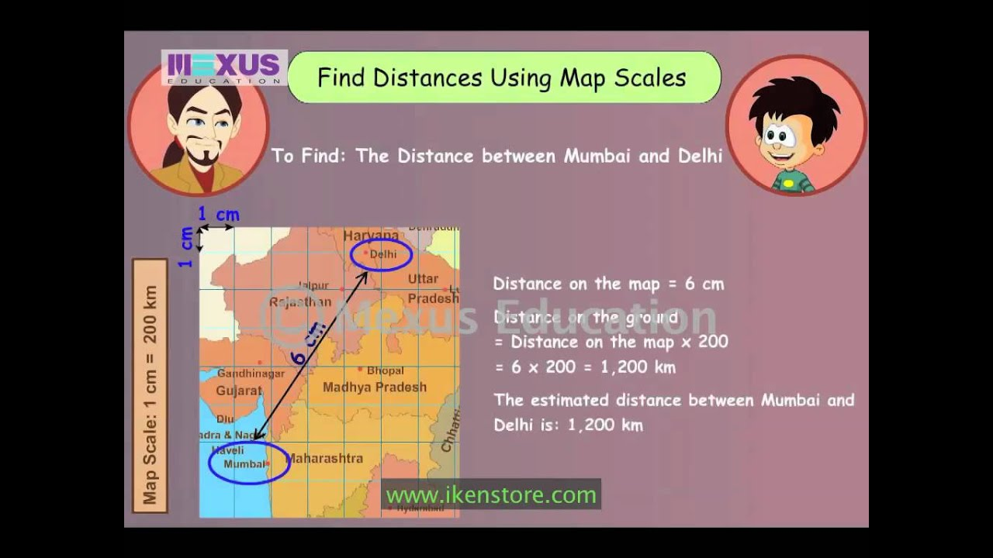

Slide 34
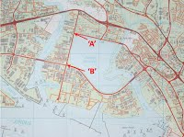
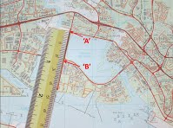
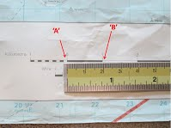
Method 1 - Measure a Straight Line Map Distance
To determine a straight line map distance, you can use a ruler as follows:
Step 1: Identify the start and end points of the distance to be measured. 'A' and B' in the example.
Step 2: Lay the ruler on the map such that the ‘0’ on the ruler is at the start point 'A' of your distance to be measured.
Step 3: Bring the ruler to the bar scale and read out the ground distance between the points.

Slide 35
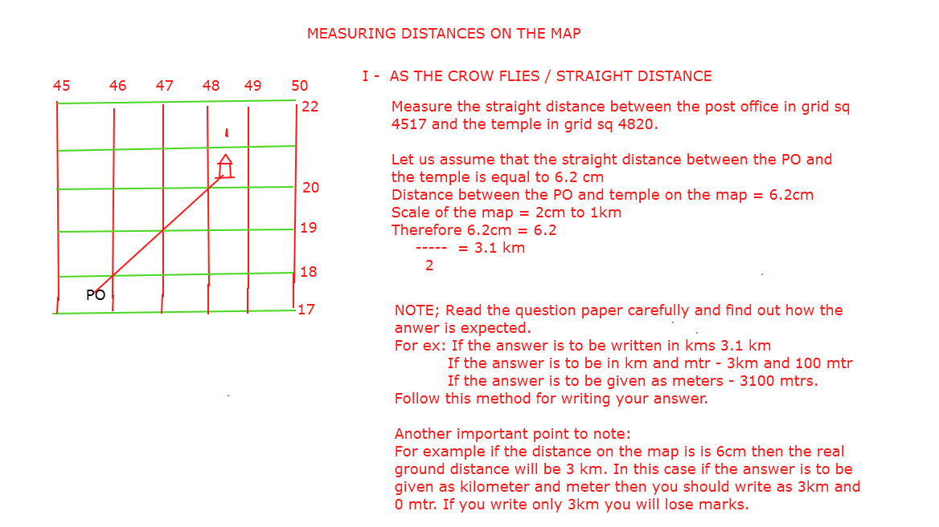

Slide 36
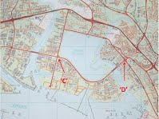
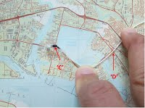
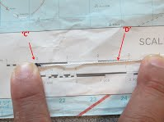
Method 2 - Measure a Curved Line Map Distance
To determine a curved line map distance, you can use a string as follows:
Step 1: Identify the start and end points of the distance to be measured. 'C' and 'D' in the example.
Step 2: Holding the thumb knot against the start point of the map distance, trace the full length of the curved line to be measured.
Step 3: Bring the string to the bar scale and read out the ground distance based on the length of the string.

Slide 37
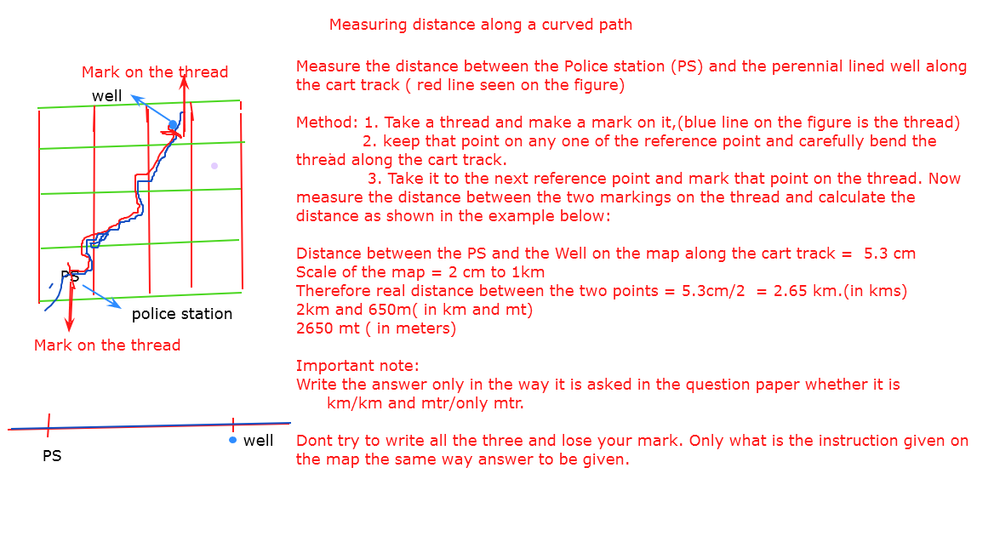

Slide 38
