Slide 1
SURVEY MAP STUDY – PART 2
CONTENT
DIRECTIONS
COLOURS USED
OCCUPATION
SETTLEMENTS
WATER FEATURES
RELIEF
TRANSPORT

Slide 2
Six colours are used in a survey map to show various features. They are as follows:
Black: All names, river banks, broken grounds, dry streams, surveyed trees, heights and their numbering, railway tracks, telephone and telegraph lines.
Yellow: All cultivated areas.
Green: All wooded/forested areas, scattered trees and scrubs.
Brown: Contour lines, their numbering, stony waste, sand features.
Blue: All water bodies, where they contain water.
Red: Grid lines and their numbering, roads, cart tracks, settlements, huts and other buildings.
Note: Sometimes we find white patches here and there to show barren lands.

Slide 3
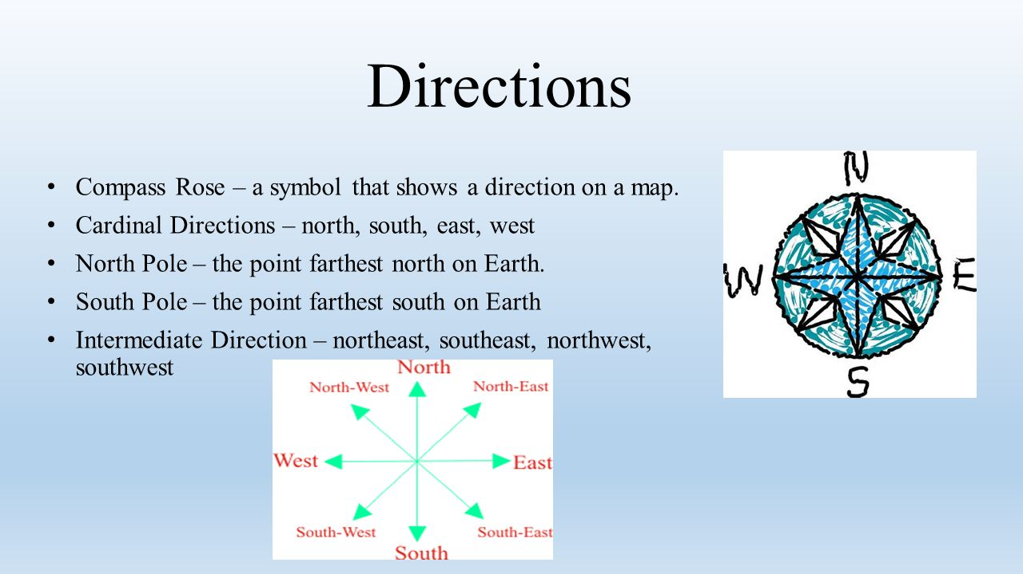

Slide 4
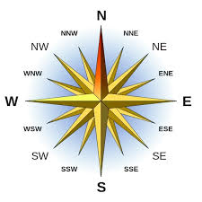

Slide 5
DIRECTION
Relative directions are in relationship to an object's current location and orientation. ...
Absolute directions are relative to a fixed frame of reference and always point in the same direction, regardless of their location. Directions like north/south and east/west are examples of absolute direction.

Slide 6


OCCUPATIONS
•Occupations have to be inferred from topo sheets as there are
no symbols to show the occupations of people.
•Sometimes, certain names like ‘farms’, ‘orchards’ provide some
evidence of these occupations.
•The following list gives you some information about occupation of
the people from a topo-sheet.

Slide 7
OCCUPATIONS OF THE PEOPLE INTERPRETED FROM TOPO SHEETS
S.NO | Occupations/land use | Evidences
1 | Forestry/ lumbering /collection of Forest products | Green shading presence of jungles shown by conventional symbols
2 | Agriculture /cultivation/farming | Yellow shading. (cultivated land) 2. Presence of perennial lined wells(blue dots)
3 | Animal rearing/ Cattle-grazing or sheep rearing | Open scrub (white patches) Presence of meadows, grasslands, pastures
4 | Quarrying and mining Working in lime/ brick kilns | Presence of quarries/mines Presence of the symbols of kilns
5 6 | Trade/ working in places like post office/police station/ worship places etc. Tourism related activities | If the conventional symbols of these places are shown in the grids given for determining the occupation. Presence of hill stations with places of tourist interest Ex: Mt. Abu in 45 D/10 map.

Slide 8
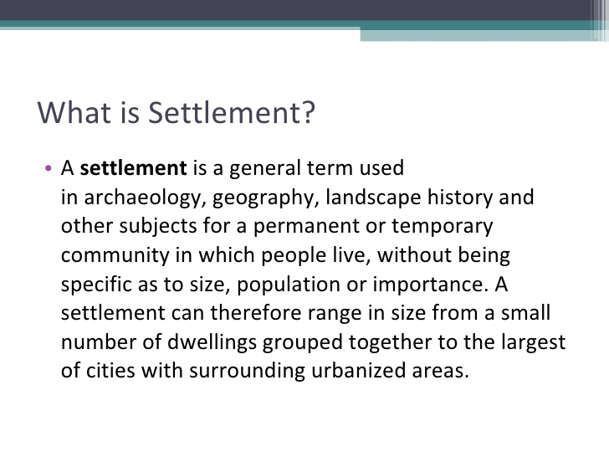

Slide 9
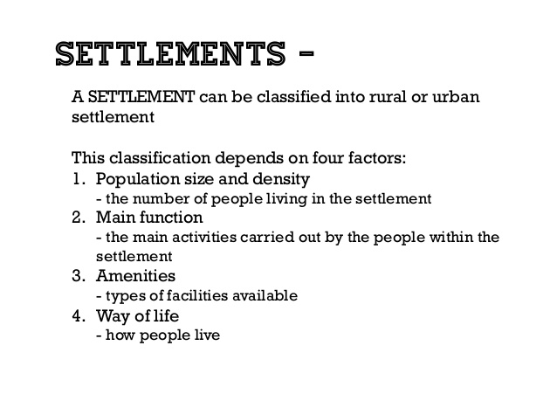

Slide 10
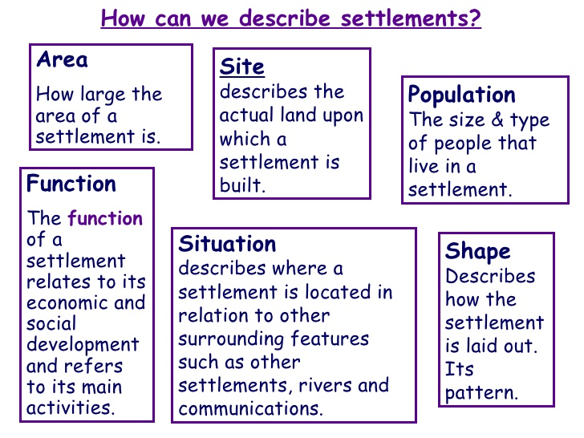

Slide 11
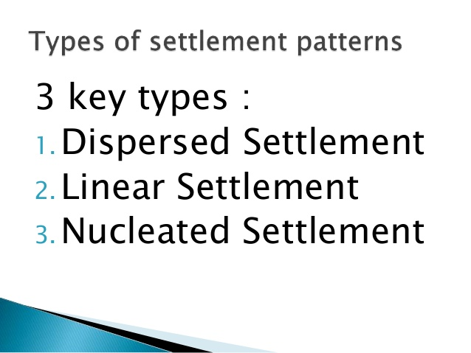

Slide 12
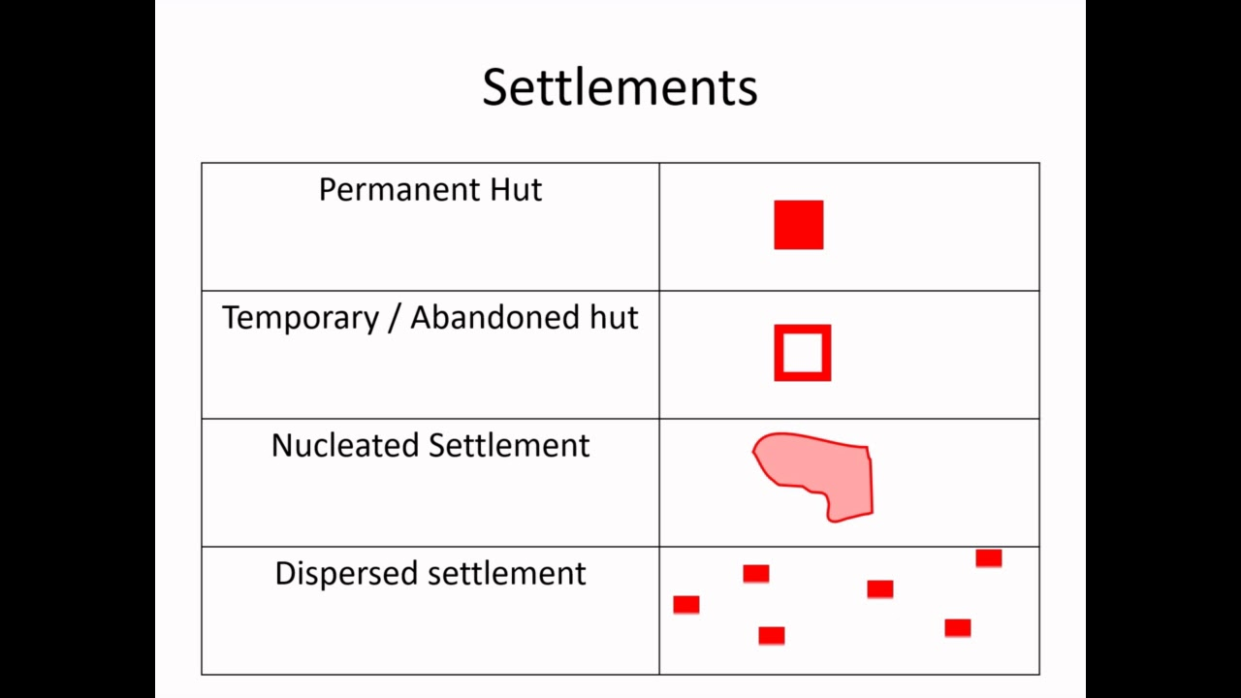

Slide 13
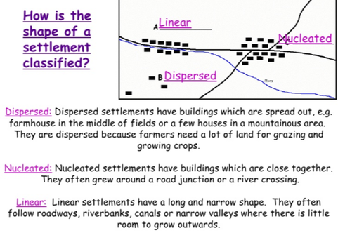

Slide 14
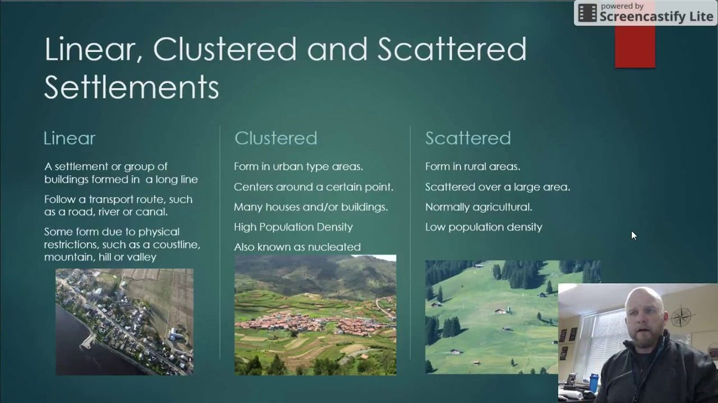

Slide 15
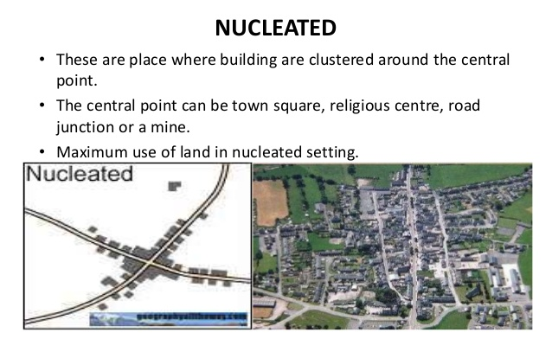

Slide 16
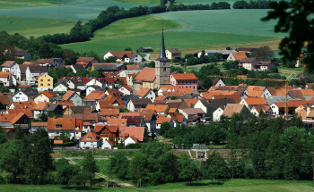
Compact settlements have the highest density of population. They have homes stacked together, often touching at the sides or stacked in multi-family buildings. Streets tend to be narrow between the rows of homes. We often find this type of arrangement in highly fertile floodplains. Houses are stacked together at a point of higher ground, which is sensible for flood-prone areas, while the majority of land uses the fertile alluvial deposits for farming.

Slide 17
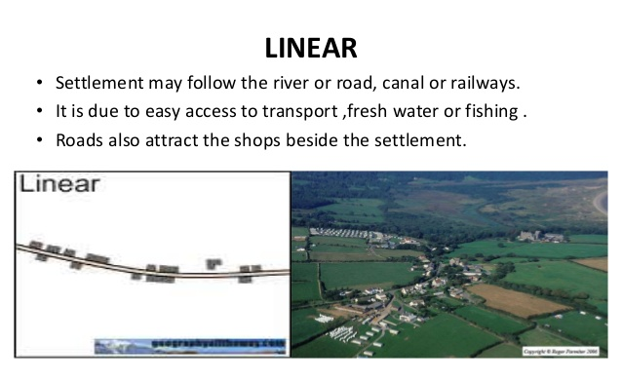

Slide 18
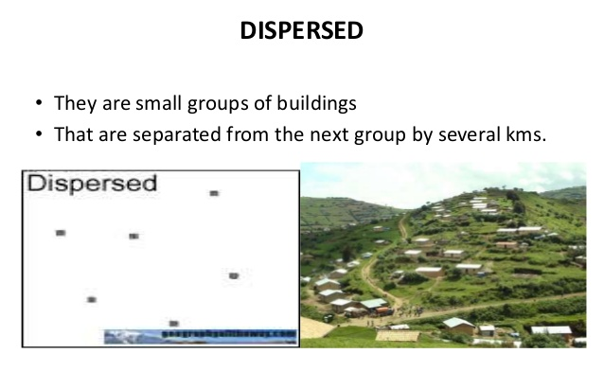

Slide 19
Conventional signs and symbols
Conventional signs and symbols represent various features shown on a map and are not drawn to scale. Most conventional signs and symbols are very easy to learn and they make using a map much easier and more clear.
There are three types of map symbols:
Point Symbols buildings, dipping tanks, trignometrical
beacons, permanent huts, wells. Places of
worship, PO, PTO, PS, DB, RH, CH, etc.
Line Symbols railways, roads, streams, rivers, power
lines, telephone lines etc.
Area Symbols cultivated area, forested area, open
scrubs, tanks, orchards and vineyards etc.

Slide 20
Man-made and Natural Features
•Topo sheets shows various details of an area- natural and man made features by means of conventional signs (legends), contours and pictorial diagrams in conventional colours.
•Natural features – rivers, streams, sand features, trees, broken grounds, natural ponds, unlined wells, jungles, depressions (Dep), islands (in the exposed river beds), physical features like hills, waterfalls, spurs, river valleys and cliffs, shown by contours and their heights.
•MAN made features – surveyed trees, quarries, permanent huts, causeways, mines, metalled and unmetalled roads, pack tracts, cart tracts, artificial lakes with embankments, boundaries (national and international), post offices, police chowkies and inspection bungalows, temple, church, mosque, lined and unlined wells

Slide 21
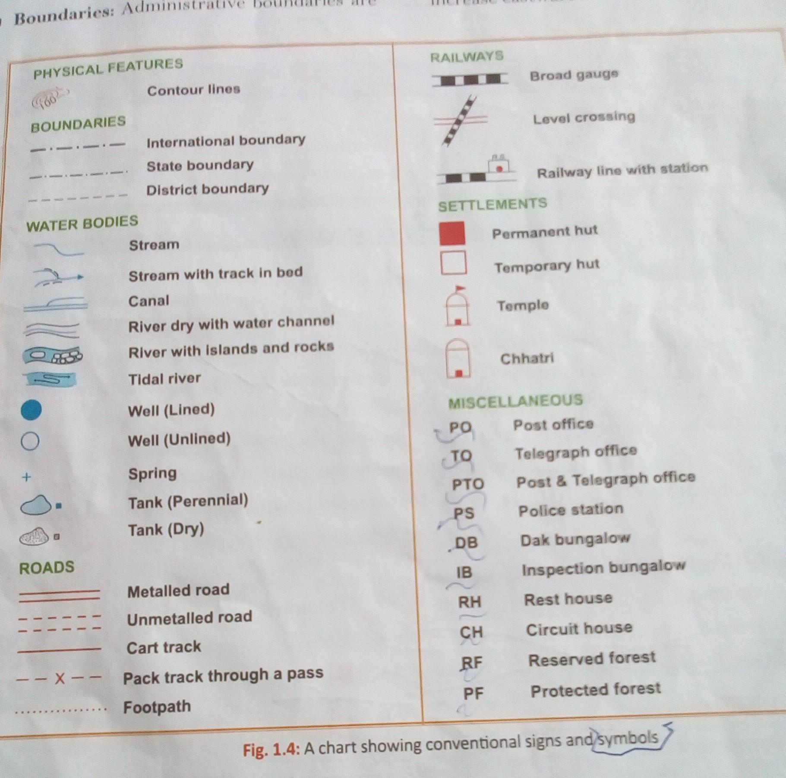

Slide 22
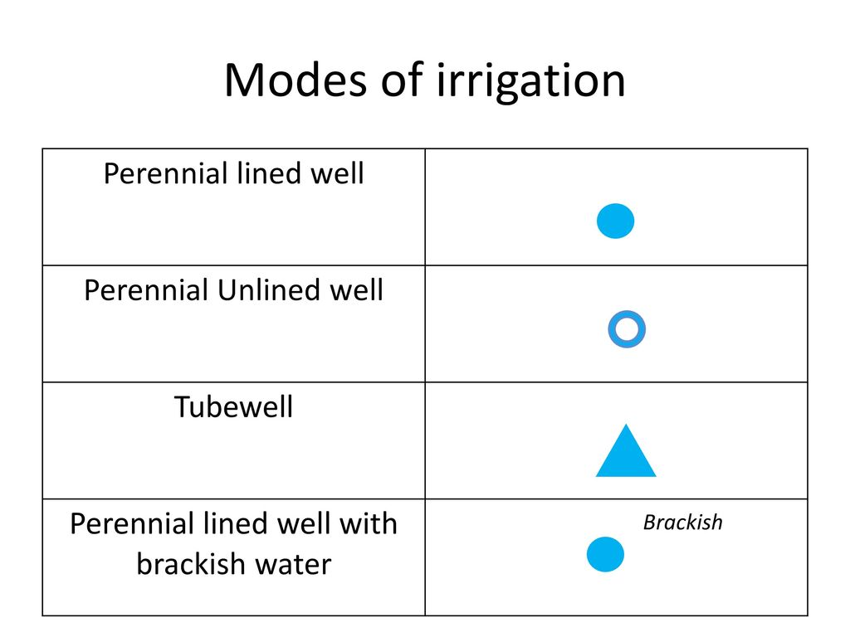

Slide 23
TYPES OF IRRIGATION AND EVIDENCE SEEN ON THE MAPS:
The common types of irrigation shown on the topo sheets include
Wells, tube wells and canal irrigation.
Wells are shown by blue circles/ dots.
Tube wells are shown by blue triangles.
(These are rare on the map)
Canals are shown by black lines radiating from a reservoir/ dam. Canals will be indicated by verbal symbol canal along the line on the map. Not many are found in this region.
Tank are mostly dry and shown by black colour and are not useful for irrigation but rarely from a reservoir/ dams water can be supplied.
Ex; pipeline from Kodra reservoir and from Nakhi talao in the 45 D/10 map provide water to Mt. Abu settlement.

Slide 24
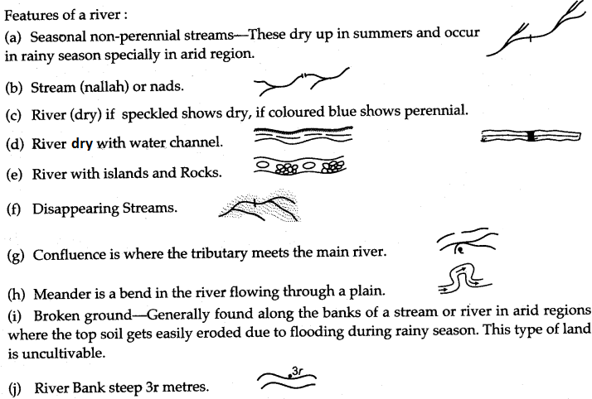

Slide 25
Ascertaining the direction of river flow:
Look for an arrow mark given on the river bed. The tail of the arrow shows the
direction from which the river comes and pointer the direction it flows.
Look for the spot heights found along the river course. Always water flows from higher altitude to lower altitude due to gravity.
The direction in which tributaries join a main river. Always tributaries will
join in the same direction in which the main river is flowing.
Locating the right or the left bank of the river:
Once the direction of the river flow is ascertained imagine you stand facing the direction of flow to your right side is the right bank and to your left is the left bank of the river.
Stand facing the river flow
Right bank
Tributary
Left bank
Main river
Direction of flow

Slide 26
Ascertaining the speed of the river:
Upper course: Speed is high.
Evidences: Hilly region/ steep slopes/
mostly streams.
Middle course: Speed is less.
Evidences: Plain region/ gentle
undulating topography/ Formation of a
river that widens/ Presence of
meanders.

Slide 27
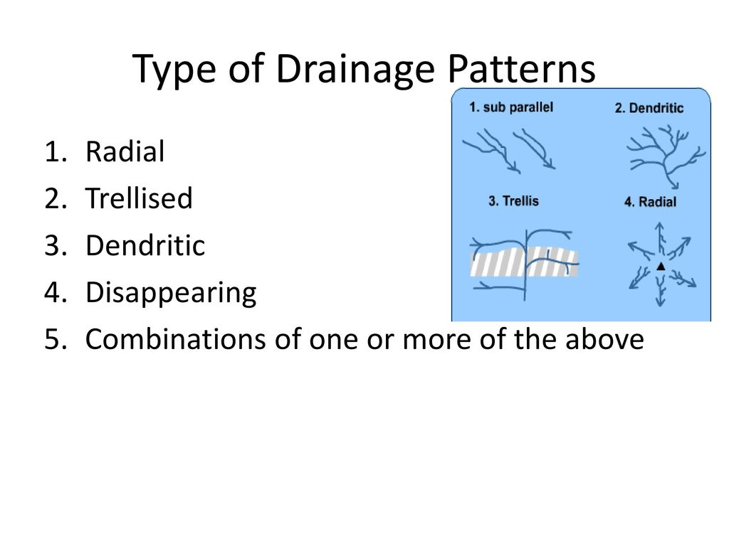

Slide 28
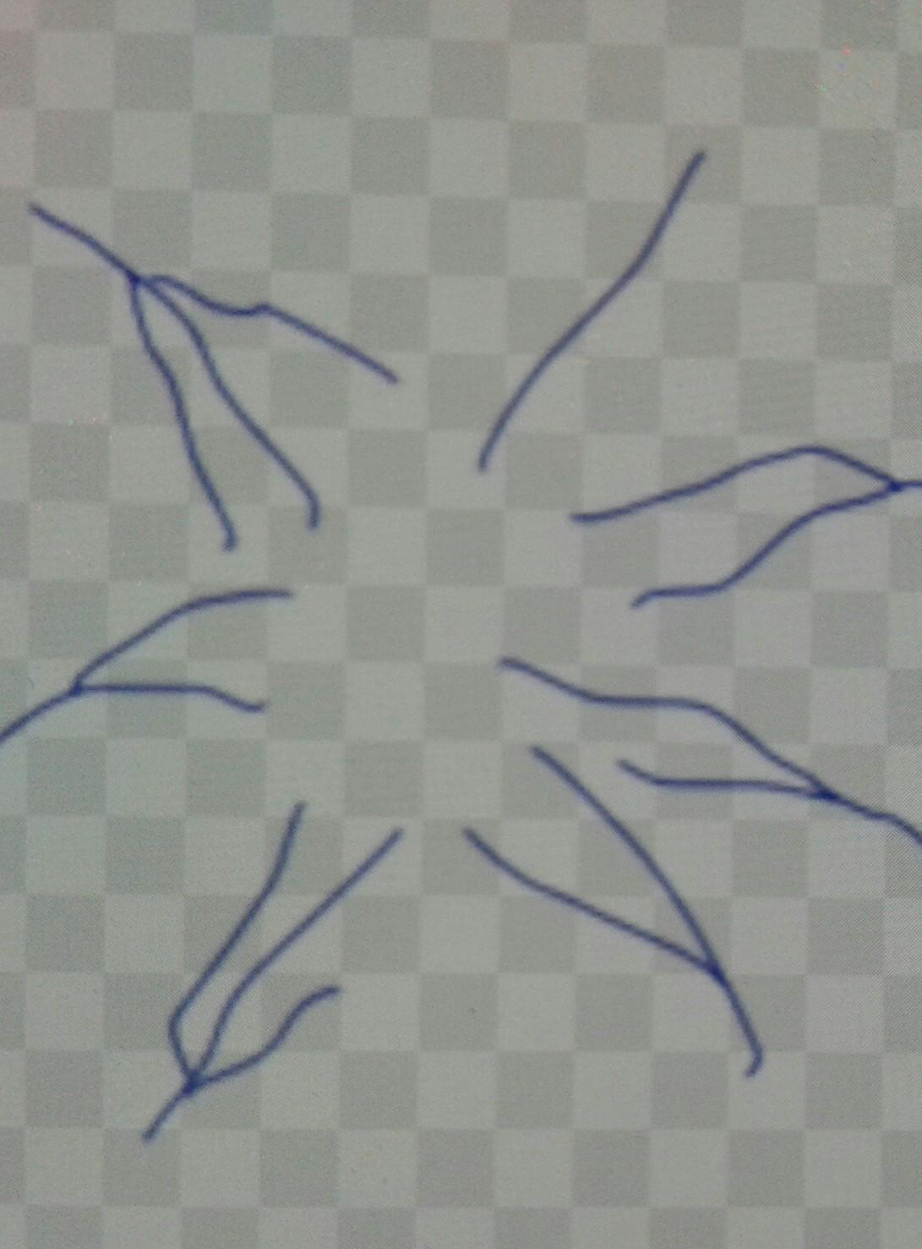
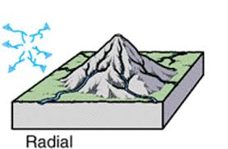
RADIAL DRAINAGE PATTERN

Slide 29
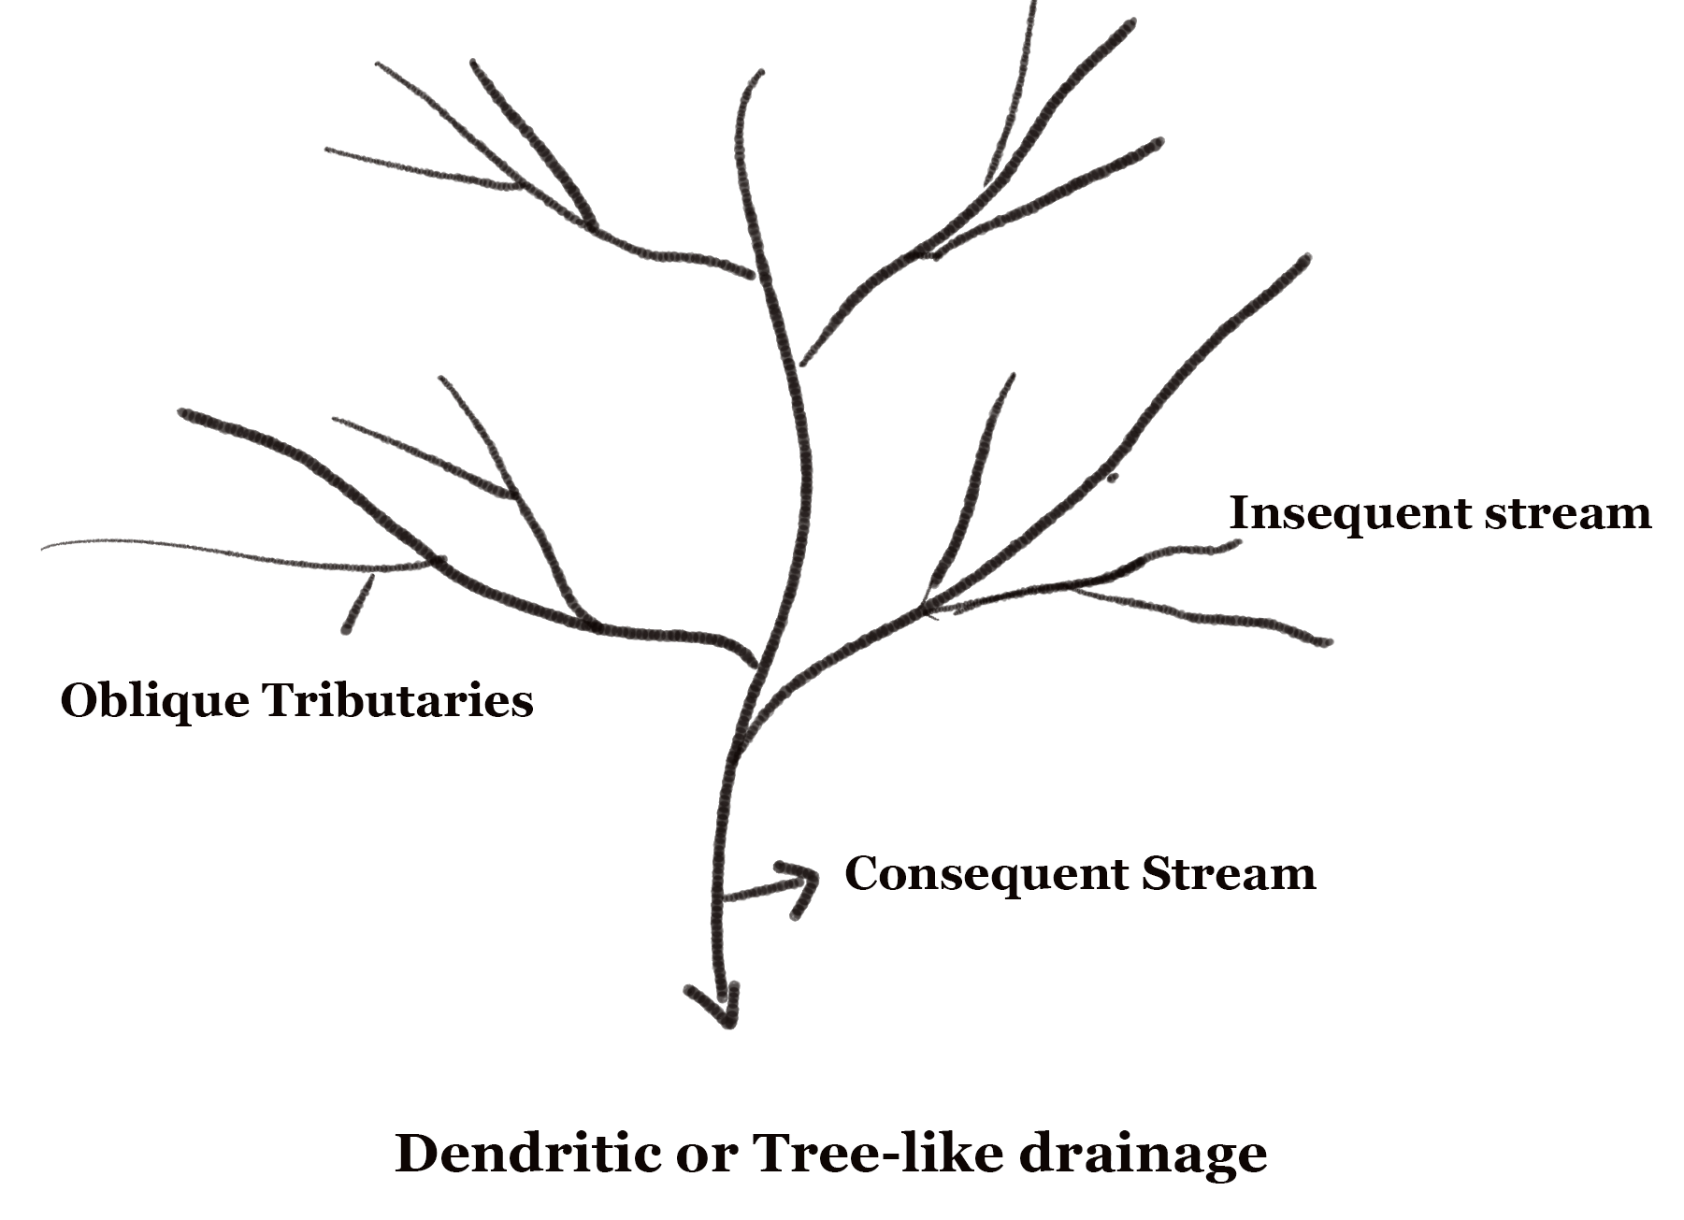

Slide 30
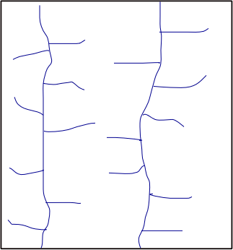
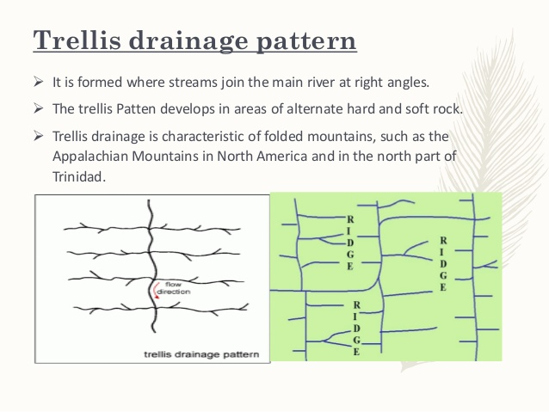
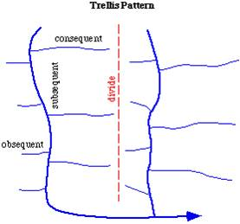

Slide 31
EVIDENCES TO SHOW THAT A REGION GETS SEASONAL RAINFALL:
Presence of the following features on the given map:
dry streams / dry rivers
Broken ground
Causeways
Dry tanks
Cart track near which written ‘motorable in dry season’
open scrub ( this must be the last option and maximum avoid writing
this. Find for the four mentioned above on the map)
Evidences to show that a river is dry:
Presence of sandy bed and shown with black colour
Presence of broken grounds
Evidence to show that a river is seasonal:
Presence of a blue line in the middle of the river bed which is called a water channel.
Reason for the presence of dry streams and dry rivers/ broken ground/ causeway/ cart tracks that are motorable in dry season / dry tanks is because of the seasonal rainfall

Slide 32
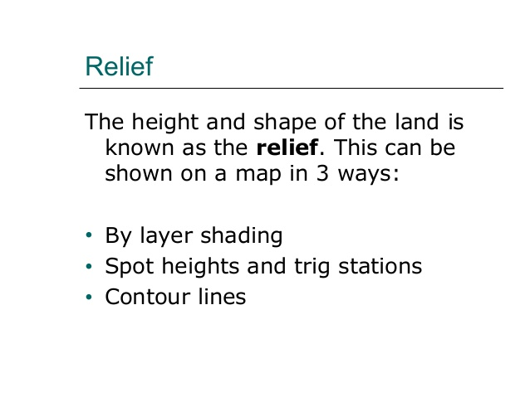
Other methods used to show the relief on maps are:
Hachures
Hill shading
Relief colours
Bench Mark

Slide 33
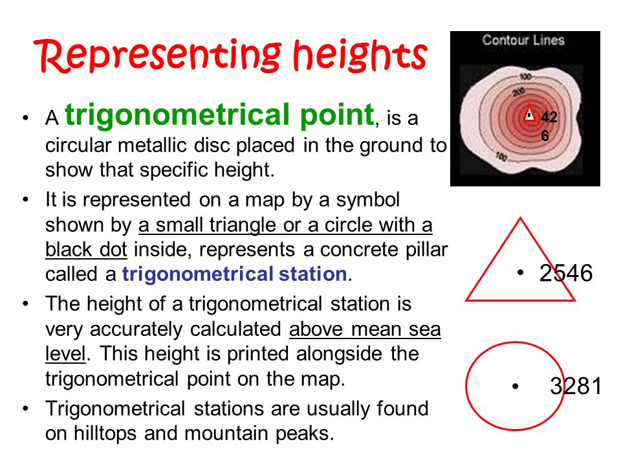

Slide 34
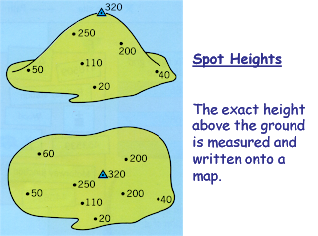

Slide 35
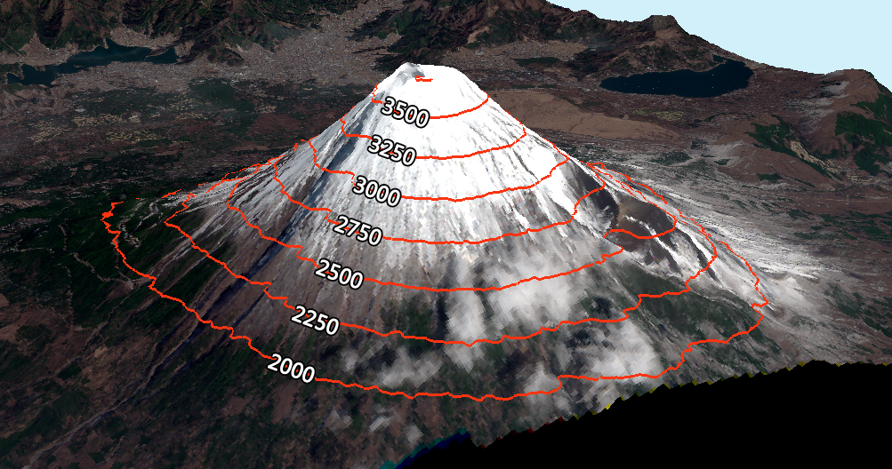
CONTOURS

Slide 36
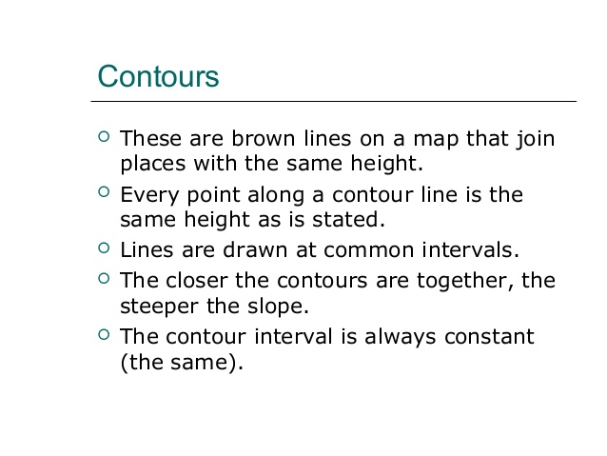

Slide 37
Some basic features of contour lines are:
A contour line is drawn to show places of equal heights.
Contour lines are drawn in brown colour.
Contour lines and their shapes represent the height and
slope or gradient of the landform.
Closely spaced contours represent steep slopes while
widely spaced contours represent gentle slope.
When two or more contour lines merge with each other,
they represent features of vertical slopes such as
cliffs or waterfalls.
Two contours of different elevation usually do not cross
each other.
CONTOUR INTERVAL IS THE DIFFERENCE IN HEIGHT BETWEEN TWO SUCCESSIVE CONTOURS.
It is 20 meters in the case of 1: 50000 topo sheets.

Slide 38
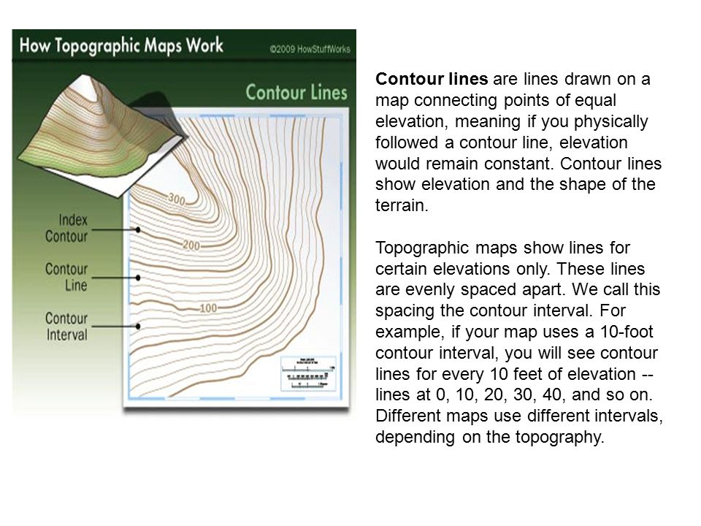

Slide 39
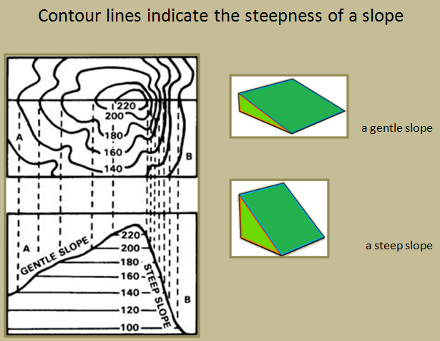

Slide 40
Use of ‘r’ in a survey map
“r” stands for relative height /depth
In blue near a well it shows the relative depth
of the perennial lined well.
2. In black inside a tank – relative depth of the tank
3. In black near an embankment- Relative ht of the embankment. Embankment is a wall built around a tank to prevent the overflow of water.
4. Written in black along river bank – relative depth of the river at that point.
5. In black on a sand hill – relative height of the sand hill/dune.
Remember to write the word relative along with height/depth as the case may be. If you write only height/ depth for a question related to ‘r’ without the word relative you will lose marks.

Slide 41

M0DES OF TRANSPORT IN SURVEY MAPS
ROADWAYS AND RAILWAYS
CONVENTIONAL SYMBOLS

Slide 42
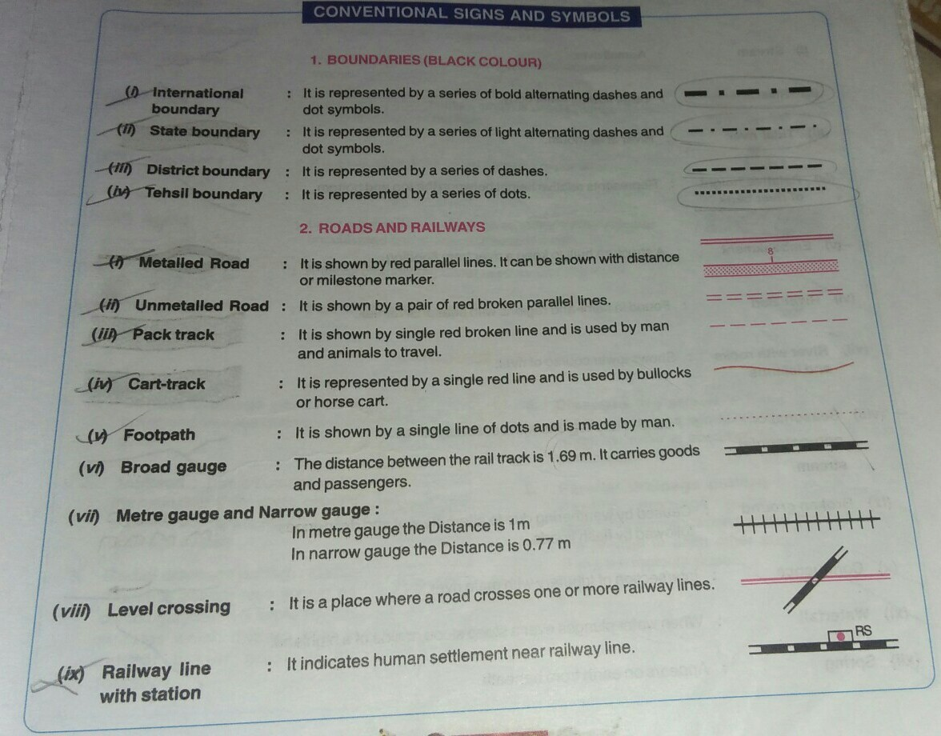

Slide 43
Means of Transport in Relation to Relief
•Transport always depend on the type of relief and drainage
•Eg. Very high altitudes, mountainous areas-only roads and no railway tracks- difficult to build at such heights
•On the map-roads are shown by means of symbols of cart tracks, pack tracts, metalled roads, unmetalled roads, footpaths with a bridge.
•Main towns- well connected by metalled roads show economic development of the area-is the indication of trade being carried on.
•Hence town are well developed.
•Causeways are raised roads across a dry stream. Presence of many causeways shows that the area gets seasonal or scanty rainfall.
•During dry season when the stream dries up, people make a habit of crossing it.
•Thus, a footpath is formed.
Roadways are only found in the 45 D/7 map.
A meter gauge railway line with a railway station is found in the 45 D/10 map at a town named Chitrasani.
Waterways are absent in these maps as all the rivers are small, mostly dry/seasonal.
Airways are also not present as the economic development of this area is very backward.

