Slide 1
MATTER
1) What is matter………..
2) How matter made up of.
3) Types of matter ………..

Slide 2

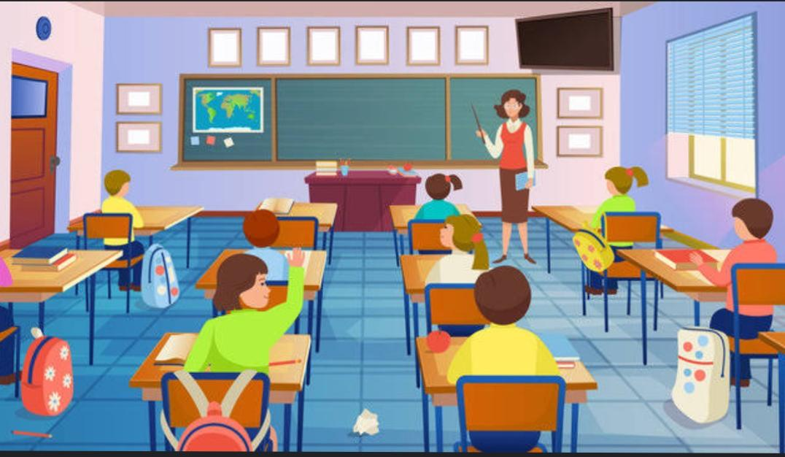

What is matter
The term matter refers to anything that occupies space and has mass—in other words, the “stuff” that the universe is made of. All matter is made up of substances called elements, which have specific chemical and physical properties and cannot be broken down into other substances through ordinary chemical reactions.

Slide 3
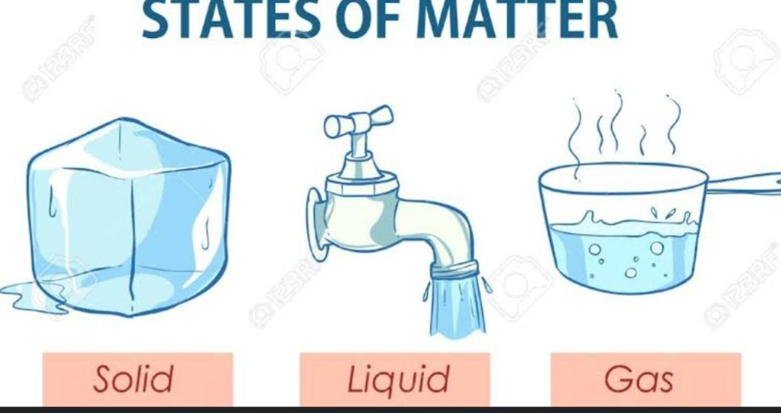
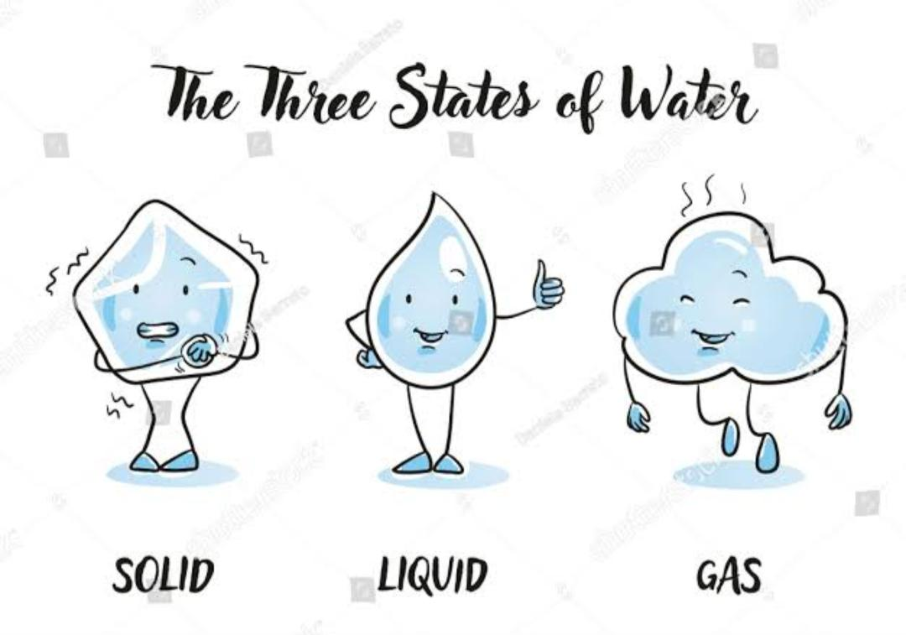
How matter is made up of and Types of matter
Matter on Earth is in the form of solid, liquid, or gas. Solids, liquids, and gases are made of tiny particles called atoms and molecules.

