Slide 1
symmetry
Introduction
Grade: 7
Subject: Math

Slide 2
symmetry
The word symmetry comes from the Greek word symmetros, which means even.
A figure has line symmetry if a line can be drawn dividing it into two identical parts.
The line is called the line of symmetry or axis of symmetry.

Slide 3
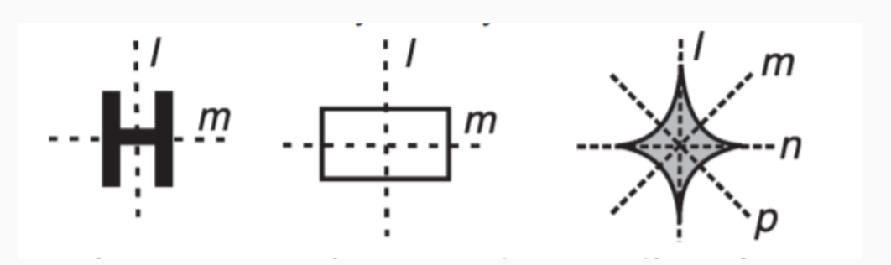
symmetry
Figures possessing more than one line of symmetry

Slide 4
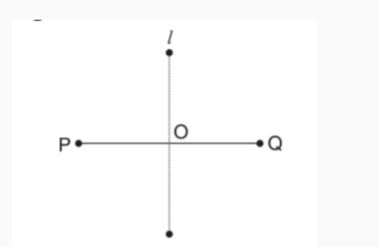
Line of symmetry for regular polygons line segment
There is one line of symmetry. The figure is symmetric along the perpendicular bisector l.

Slide 5
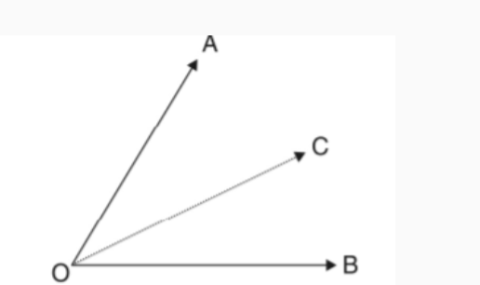
LINE OF SYMMETRY FOR REGULAR POLYGONS angle
There is one line of symmetry. The figure is symmetric along the angle bisector OC.

Slide 6
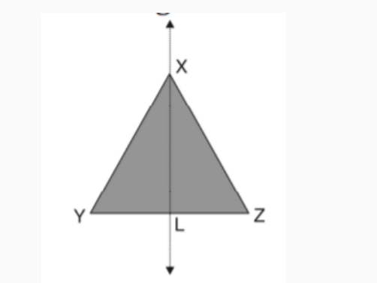
LINE OF SYMMETRY FOR REGULAR POLYGONS an isosceles triangle
There is one line of symmetry. The figure is symmetric along the bisector of the vertical angle. The median XL.

Slide 7
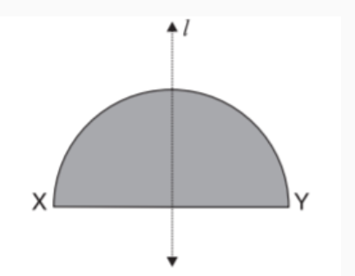
LINE OF SYMMETRY FOR REGULAR POLYGONS semi circle
There is one line of symmetry. The figure is symmetric along the perpendicular bisector l of the diameter XY.

Slide 8
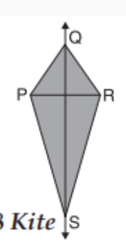
LINE OF SYMMETRY FOR REGULAR POLYGONS kite
There is one line of symmetry. The figure is symmetric along the diagonal QS.

Slide 9
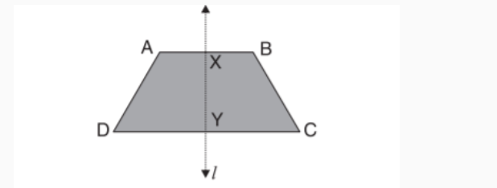
LINE OF SYMMETRY FOR REGULAR POLYGONS isosceles trapezium
There is one line of symmetry. The figure is symmetric along the line l joining the midpoints of two parallel sides AB and DC.

Slide 10
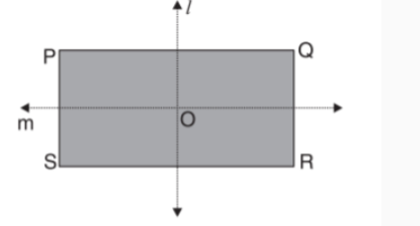
LINE OF SYMMETRY FOR REGULAR POLYGONS rectangle
There are two lines of symmetry. The figure is symmetric along the lines l and m joining the midpoints of opposite sides.

Slide 11
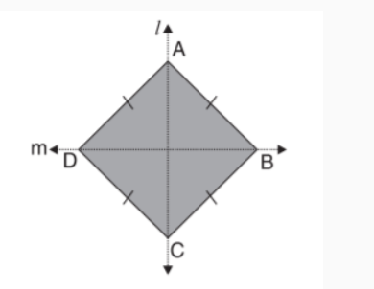
LINE OF SYMMETRY FOR REGULAR POLYGONS rhombus
There are two lines of symmetry. The figure is symmetric along the diagonals AC and BD of the figure.

Slide 12
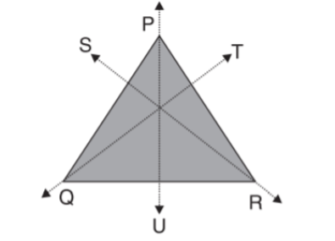
LINE OF SYMMETRY FOR REGULAR POLYGONS equilateral triangle
There are three lines of symmetry. The figure is symmetric along the 3 medians PU, QT and RS.

Slide 13
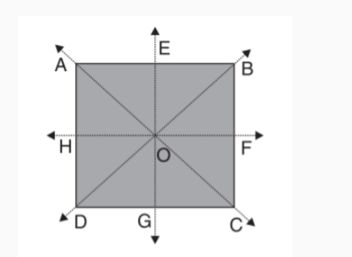
LINE OF SYMMETRY FOR REGULAR POLYGONS square
There are four lines of symmetry. The figure is symmetric along the 2 diagonals and 2 midpoints of opposite sides.

Slide 14
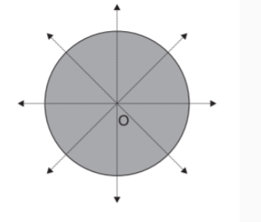
LINE OF SYMMETRY FOR REGULAR POLYGONS circle
There are infinite lines of symmetry. The figure is symmetric along all the diameters.

Slide 15
LINES OF SYMMETRY IN LETTERS OF THE ENGLISH ALPHABET
Letters having one line of symmetry
A B C D E K M T U V W Y have one line of symmetry.
A M T U V W Y have vertical line of symmetry.
B C D E K have horizontal line of symmetry.

Slide 16
LINES OF SYMMETRY IN LETTERS OF THE ENGLISH ALPHABET
Letter having both horizontal and vertical lines of symmetry:
H I X have two lines of symmetry.
Letter having no lines of symmetry:
F G J L N P Q R S Z have neither horizontal nor vertical lines of symmetry.

Slide 17
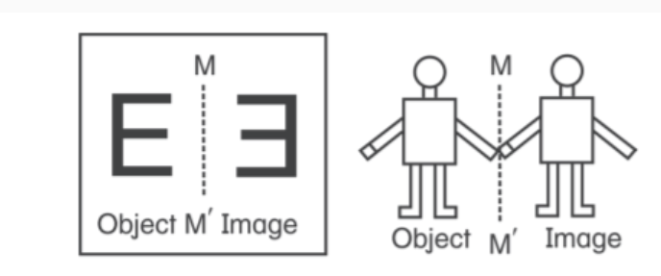
Reflection symmetry
In reflection symmetry, one part is the object and the other part is the image and they are at an equal distance from the mirror line (line of symmetry).

