Slide 1
Visualising solid shapes
Introduction
Grade: 7
Subject: Math

Slide 2
Dimensions of 3-d shapes
Faces, Vertices, and Edges of a 3-dimensional Figure
(i) Faces: Each flat part of a solid is called its face.
(ii) Vertices: Each corner where three faces of a solid meet are called its vertex. The plural of vertex is vertices.

Slide 3
Dimensions of 3-d shapes
(iii) Edges: The two faces of a solid meet in a line, called an edge.
Now, we shall discuss the faces, vertices, and edges of some 3-dimensional figures having flat faces.

Slide 4
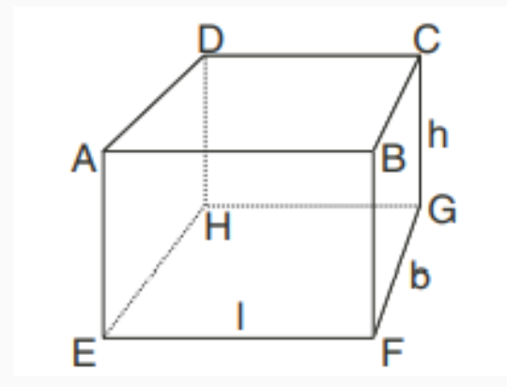
cuboid
Cuboid: A solid bounded by six rectangular plane regions is called a cuboid.
This figure represents a cuboid with length (l) m, breadth (b) m height (h) m respectively.

Slide 5
Faces of a cuboid
We observe in this figure that the cuboid is made of six rectangular plane regions,
i.e. ABCD (top), EFGH (bottom), ABFE (front), CDHG (back), ADEH (left) and CBEG (right).
These regions are better known as faces.

Slide 6
FACES OF A CUBOID
Any face of a cuboid may be called as its base.
The top and the bottom face, the front and the back face, the left and the right face respectively form pairs of opposite faces.
Any two faces having a common edge are known as adjacent faces. For example, in Fig. ABCD and ABFE are adjacent faces.
The four faces which meet the base are called lateral faces of the cuboid.

Slide 7
Edges and vertices of a cuboid
Edges of Cuboid: A cuboid has 12 edges. In the above figure 12 edges of the cuboid are, AB, BC, CD, DA, EF, FG, GH, HE, AE, DH, BF, CG.
Vertices of Cuboid: A cuboid has 8 vertices in all. The vertices of cuboid are A, B, C, D, E, F, G, H.

Slide 8
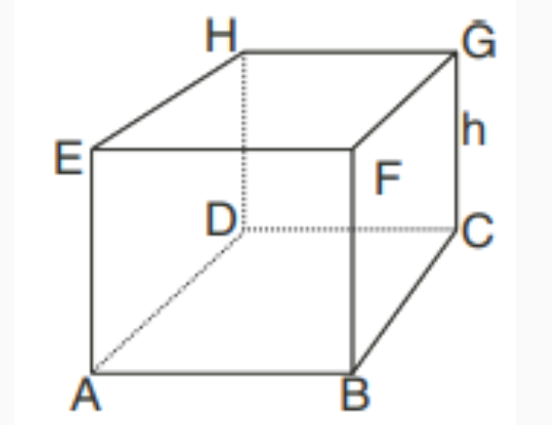
cube
Cube: A cube is a cuboid whose length, breadth and height are equal. For example : Ice cubes, sugar cubes, dice etc. are all cubes.
The cube ABCDEFGH whose length (l),
breadth (b) and
height (h) are all equal.

Slide 9
Faces of a cube
Faces of Cube: It is observed that a cube has 6 faces i.e. ABCD, EFGH, ADHE, BCGF, ABFE and DCGH. They are square plane regions.
Each face of a cube is a square.

Slide 10
Vertices of a cube
Vertices of Cube: A cube has 8 vertices. In the above figure A, B, C , D, E, F, G, H are the vertices of the cube.

Slide 11
Edges of a cube
Edges of Cube: A cube has 12 edges. In the above figure AB, BC, CD, DA, EF, FG, GH, HE, AE, DH, BF, CG
are the edges of cube.

Slide 12
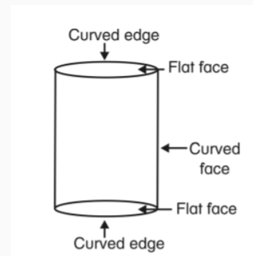
cylinder
A cylinder is a solid figure of uniform circular cross-section in which the curved surface is at right angle to the base.
A cylinder has 1 curved face and 2 flat faces.
It has 2 curved edges.
It has no vertex.

Slide 13
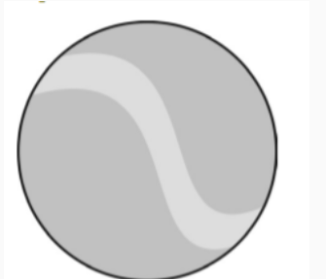
sphere
A sphere is a solid generated by the revolution of a semicircle about its diameter as axis.
Solids like balls, lead shots and marbles are spherical in shape.
It has no vertex or edge.
A sphere has a curved surface.

Slide 14
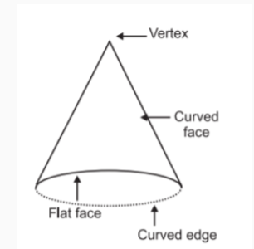
cone
A cone is a solid having a circular base and which is connected by a curved surface to its vertex into a point.
A cone has one vertex and one curved edge.
It has one curved face and one flat face.

Slide 15
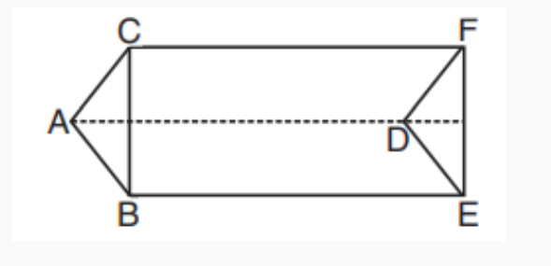
Triangular prism
(a) Triangular prism: A triangular prism is made up of two parallel end faces, each of which is a triangle and three lateral faces each one of which is a rectangle.

Slide 16
TRIANGULAR PRISM
A triangular prism has 2 triangular faces and 3 rectangular faces.
In the figure,
∆ABC and ∆DEF are its triangular faces.
ABED, ADFC and CBEF are its rectangular faces.

Slide 17
TRIANGULAR PRISM
It has 6 vertices, namely, A, B, C, D, E and F.
It has 9 edges, namely, AB, BC, CA, DE, EF, FD, AD, BE and CF.

Slide 18
pyramid
Pyramid: A pyramid is a solid whose base is a plane rectilinear figure and whose side faces are triangles having
a common vertex and is known as the vertex of the pyramid.
Types of Pyramids
Square pyramid
2. Rectangular pyramid
3. Triangle pyramid

Slide 19
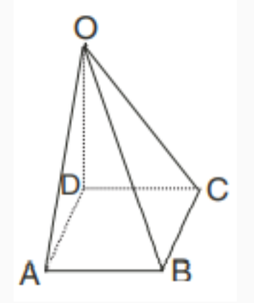
Square pyramid
(a) Square Pyramid: It is a solid whose base is a square and whose side faces are triangles having a common vertex.
It has 5 vertices, 5 faces (1 square and 4 triangular faces) and 8 edges.

Slide 20
Square pyramid
There are 5 faces in a square pyramid
One of which is a square face namely ABCD
Four are triangular faces namely OAD, OAB, OBC and OCD

Slide 21
Square pyramid
In the above figure, OABCD, is a square pyramid with its vertex O.
It has 5-vertices namely, O, A, B, C, D
It has 8 edges namely, AB, BC, CD, DA, OA, OB, OC and OD.

Slide 22
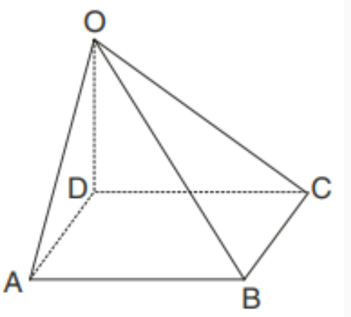
Rectangular pyramid
(b) Rectangular Pyramid: It is a solid whose base is a rectangle and whose side faces are triangles having a common vertex.
OABCD is a rectangular pyramid.

Slide 23
REctangular pyramid
Rectangular Pyramid has
5 vertices namely, O, A, B, C and D
1 rectangular face namely ABCD
4 triangular faces, OAD, OBC, ODC, OAB
8 edges AB, BC, CD, DA, OA, OB, OC, OD

Slide 24
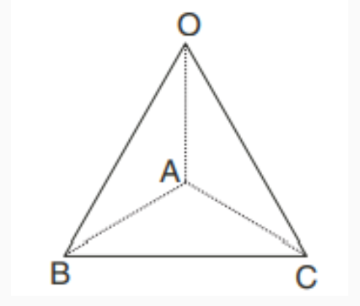
Triangular pyramid
(c) Triangular Pyramid: It is also called tetrahedron. It is a solid whose base is a triangle and whose side faces are triangles having a common vertex.

Slide 25
Triangular pyramid
In the above figure, OABC is a triangular pyramid.
It has 4-vertices, namely, O, A, B, C,
4-triangular faces namely, ABC, OAB, OAC, OBC
6-edges, namely AB, BC, CA, OA, OB and OC.

