Slide 1
AIR POLLUTION

Slide 2
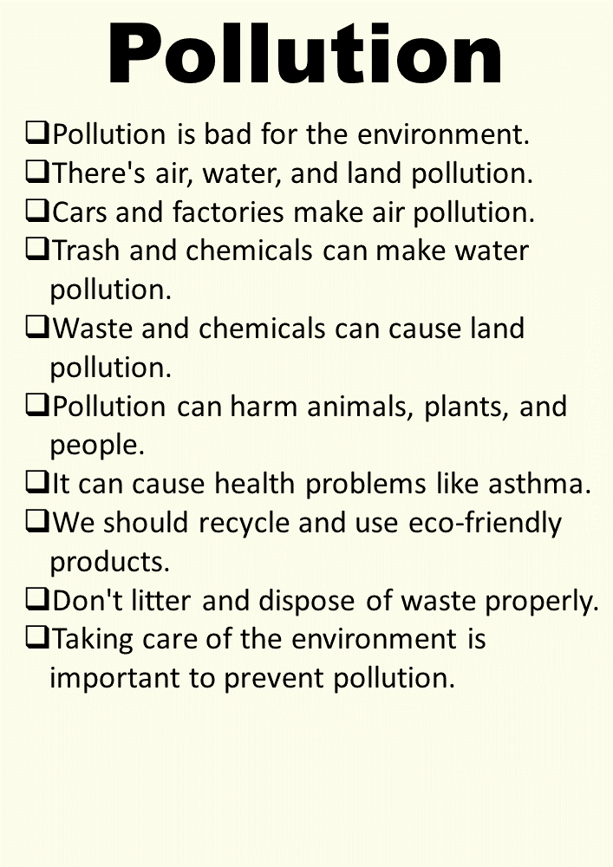

Slide 3
THANK YOU

